Slide 1
iSupplier Portal Training

Slide 2
iSupplier
The iSupplier portal is the communication system that is used between Navistar and our suppliers to communicate changes on purchase orders.
They use the iSupplier Portal to notify us of changes that are going on with the cost, sale sets, and/or if part is obsolete or replaced.

Slide 3
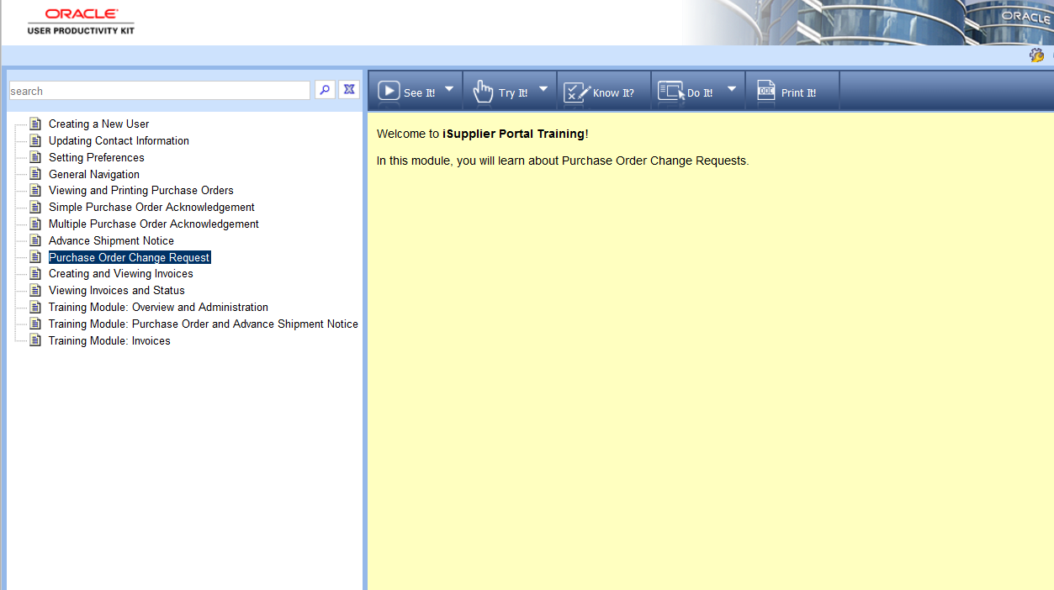
Supplier’s Training/ Change Request Submissions
https://evalued.internationaldelivers.com/dna-upk-ex/toc0.html

Slide 4
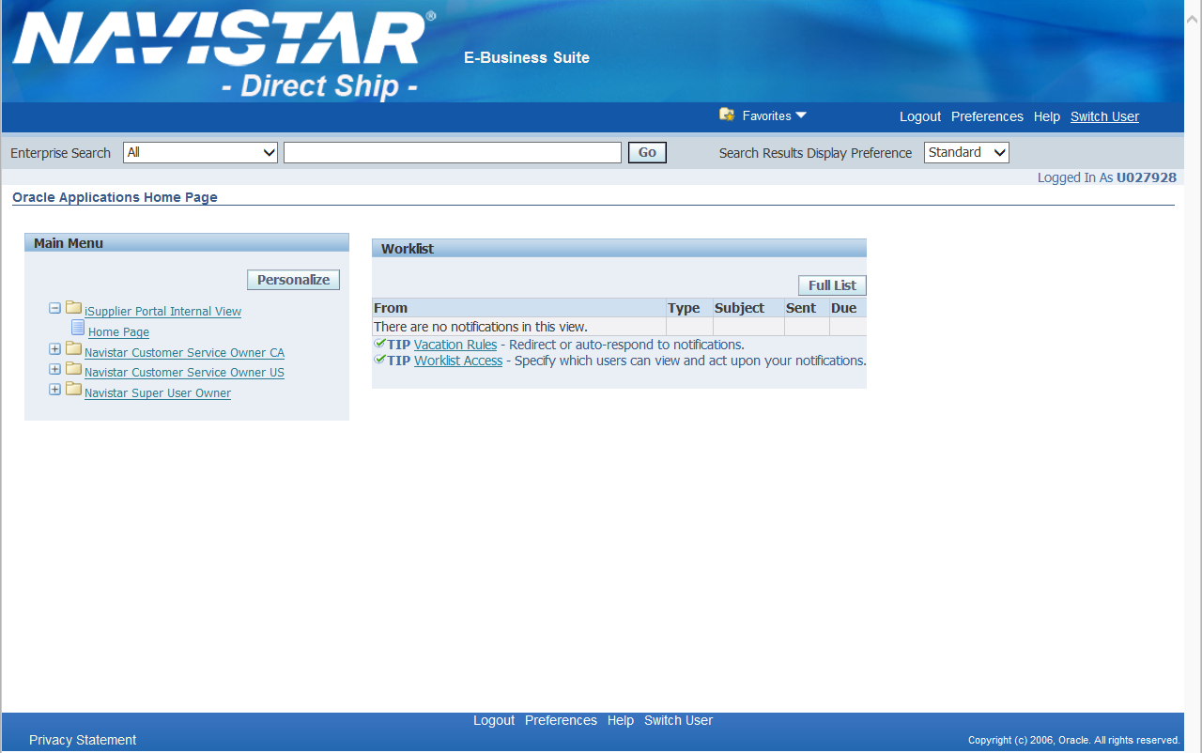
Main Screen
Click “Switch User”

Slide 5
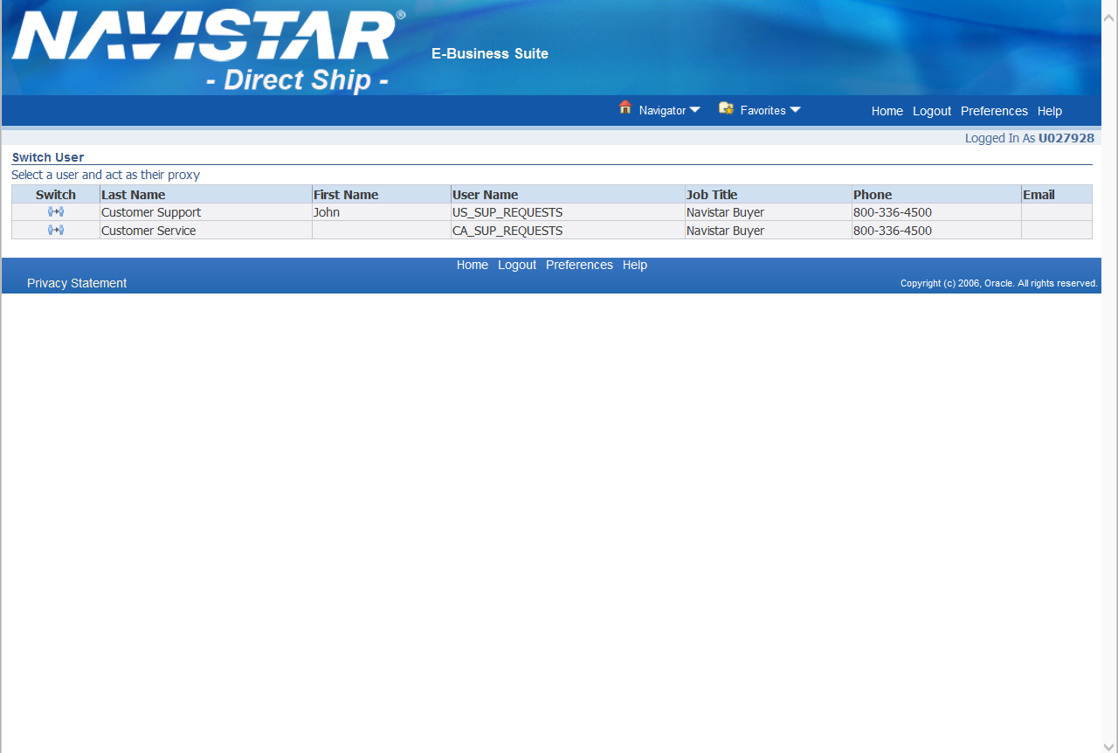
Switch User
You must switch the user to complete the change requests for US and CA.
Click on here to Switch
User.

Slide 6
Main Menu

Slide 7
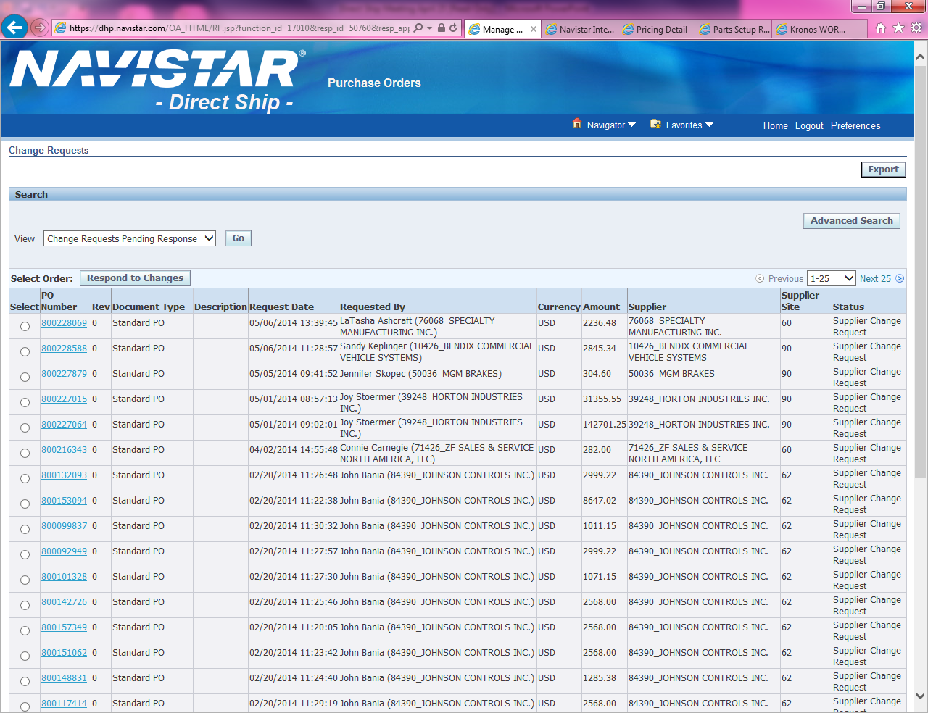
Purchase Orders
Click on PO # to open up the request from the supplier that is connected to that PO #.

Slide 8
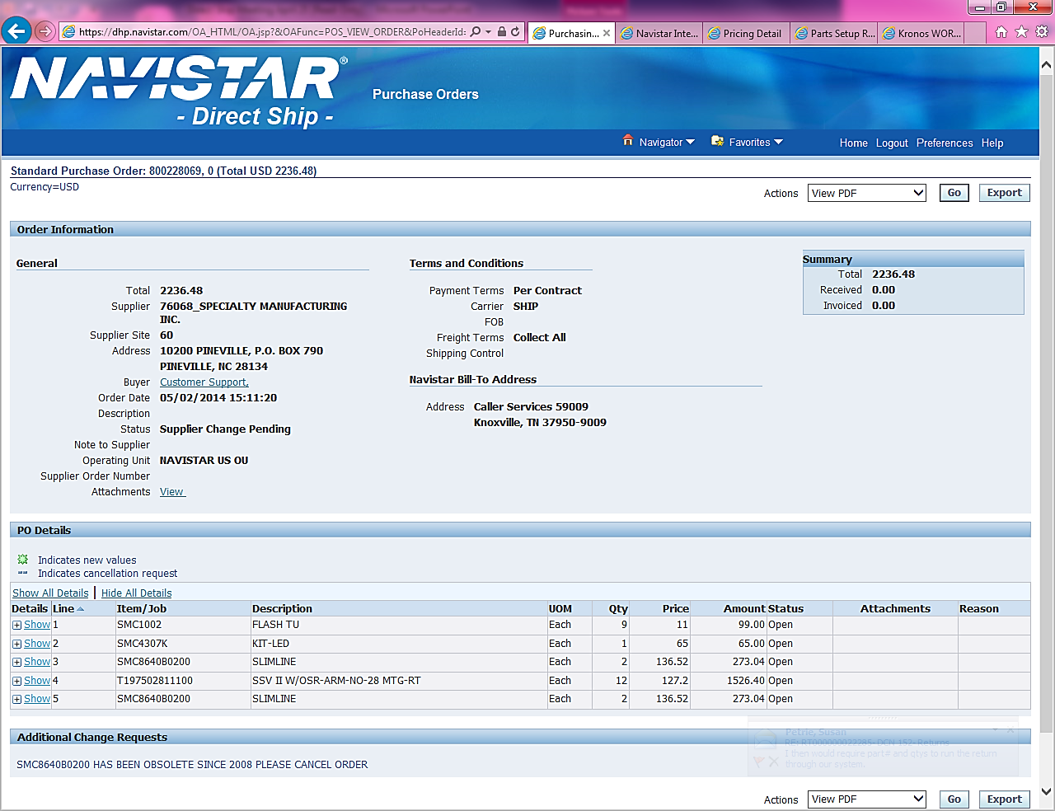
Order Information
Supplier’s comments and request. These are the changes you will be processing.

Slide 9
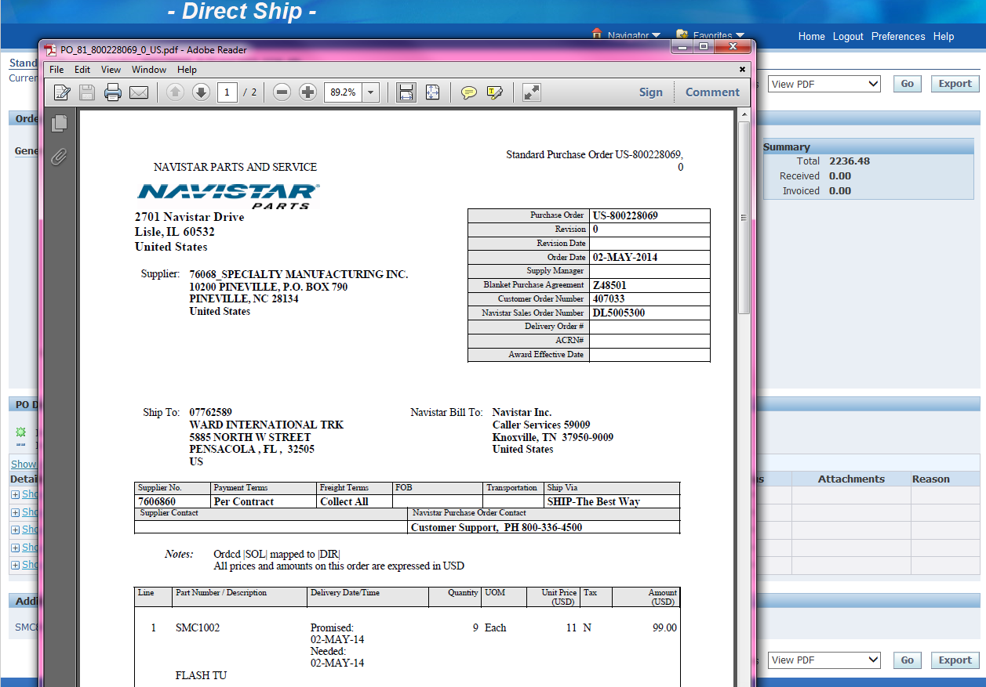
Viewing Purchase Order Information
You can review if there has been a revision sent to the supplier on the upper right hand corner next to the PO number.
When you click on “View PDF” you will be able to view the detail information of the PO.

Slide 10
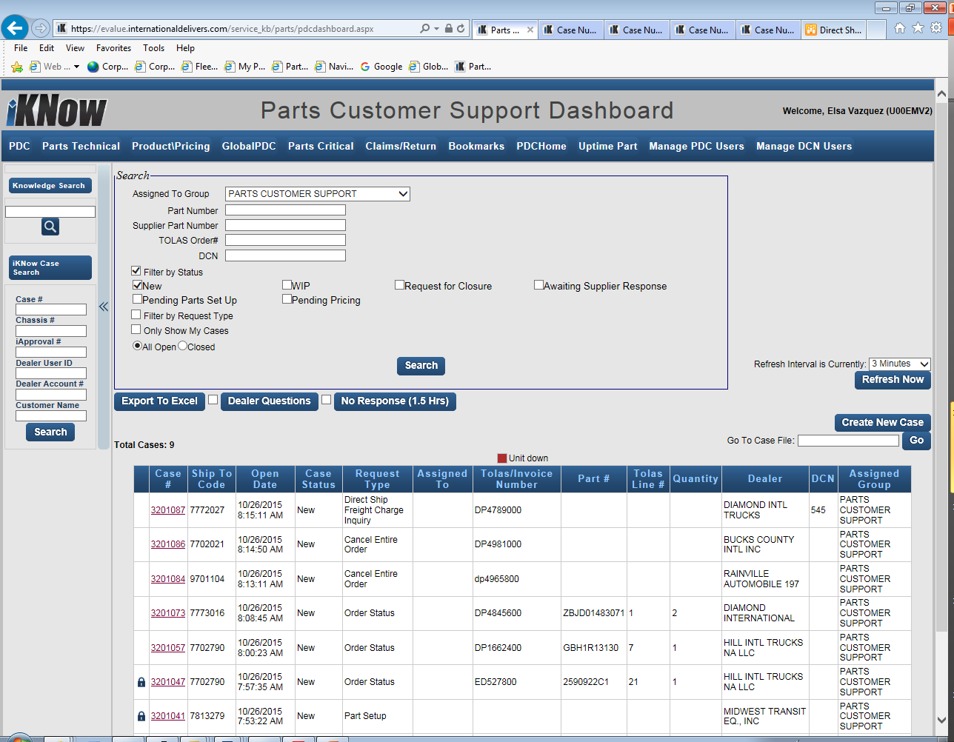
Create an iKnow case
You will need to create an iKnow case under the PDC dashboard
Please select the appropriate drop down pertaining to your request
Please reference departmental SOP for assistance with case submission
The Product Pricing group will update the case file with their findings.

Slide 11
Product and Pricing
Once we have created the iKnow case with the change request information from the supplier, Product and Pricing will then take the information and either update it in our end (if we have it incorrect) or go back to the supplier and negotiate.
Navistar requires 90 days notice on changes.

Slide 12
Supplier’s Request
On the iKnow case file we must enter all the information that Product and Pricing will need in order to process the change request.
Example; Date, Supplier Name, Blanket PO#, PO#, Part Number, Issue, New part # if applicable, Correct Cost if applicable, and / or Correct Sales Set if applicable.

Slide 13
Obsolete/ Replaced Change Request
If the part is Obsolete or Replaced:
Obsolete:
Enter the information on the iKnow case.
Call the dealer to inform them that we will be canceling the PN from the order/ PO
Cancel it on TOLAS.
Replaced:
If the replacement PN is not set up, we must submit an iKnow case to have it set up.
If replacement is set up, we can offer to the dealer to place the new order with the PN.

Slide 14
Sale Sets/ Cost
If the Sale Set or Cost needs to be changed:
Sale Sets:
Add the correct sale sets to the iKnow case,
Call dealer and advise if they would like to add or cancel.
Cost:
We add to iKnow case, we make no changes in TOLAS.

Slide 15
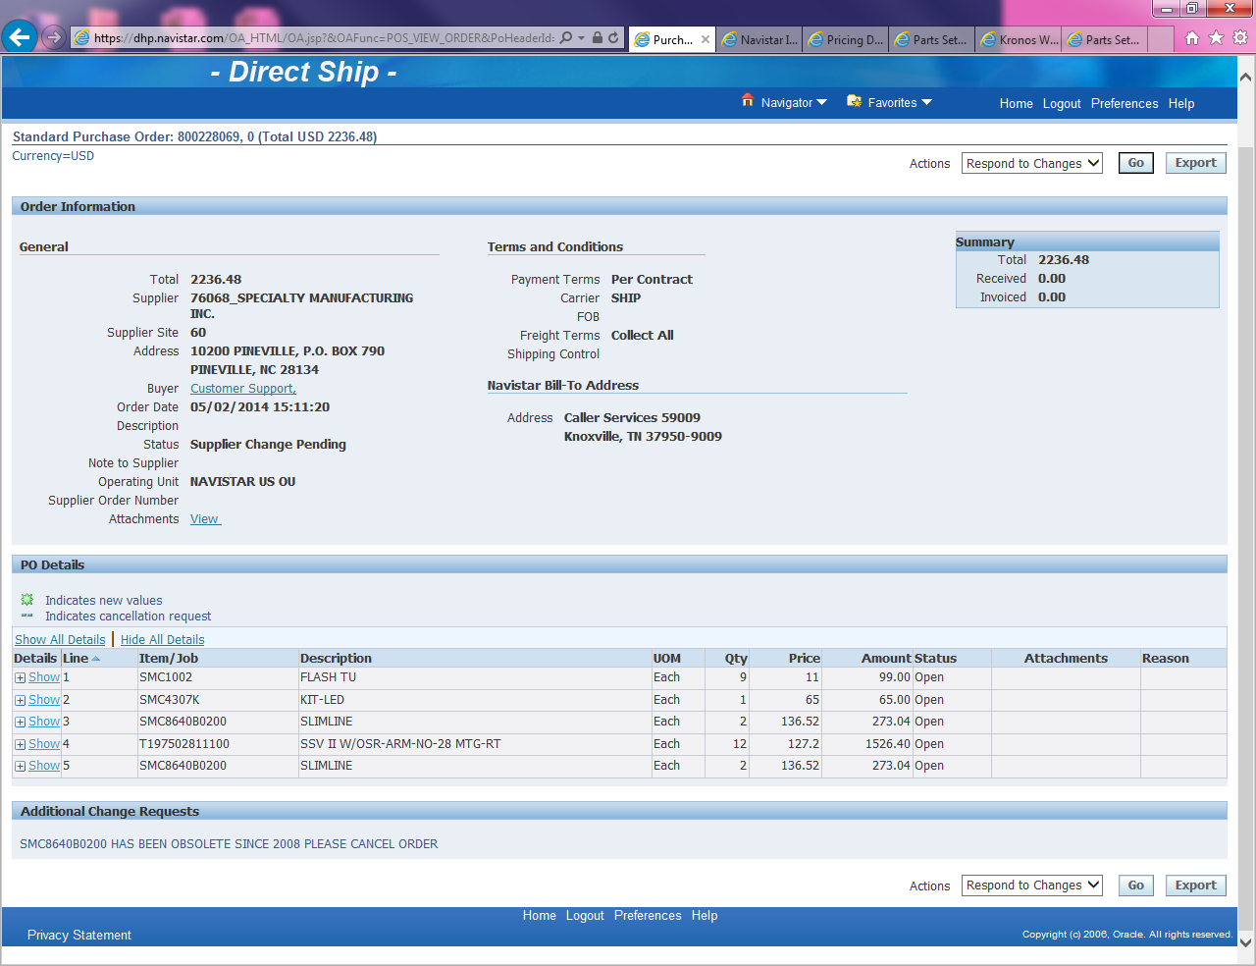
Respond to Changes
For ALL request we must “Respond to Changes”

Slide 16
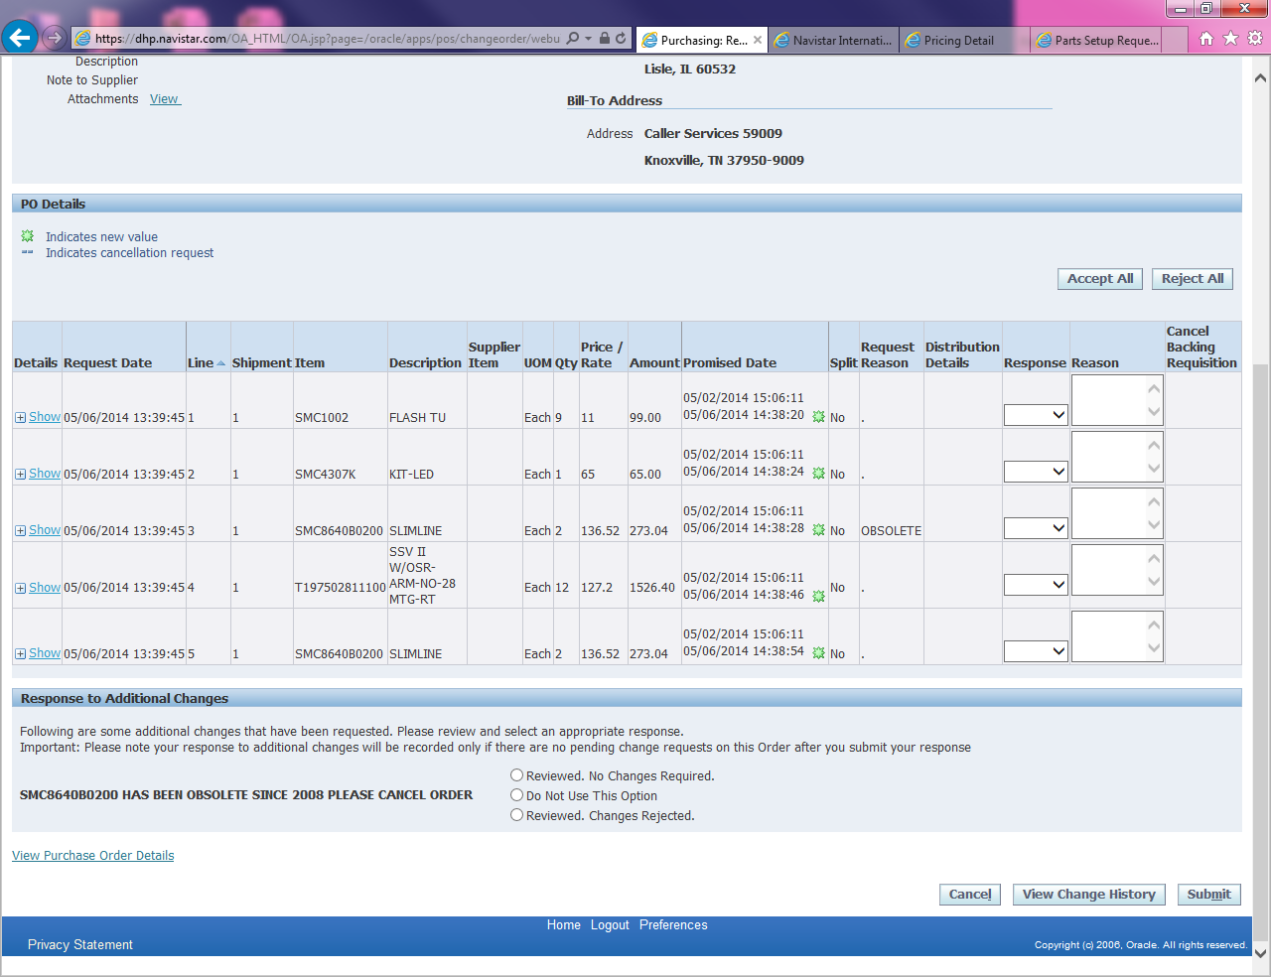
Accept Changes
The response should always be “Accept” and the we hit submit. Once we hit submit the supplier gets confirmation that we have review the request and are aware/accepted the changes.

Slide 17
Questions?

