Slide 1





Tooling Summit Supplier Based Tooling September 11, 2012
Document Version 1.0

Slide 2
Tooling Summit – (Ground Rules)
Hold Questions – Time permitting at the end of each Presentation, Before we break for lunch - (More detailed Questions can be addressed in the breakout sessions).
Please enjoy Water and Coffee anytime
Washrooms are located out the doors and to the right
Box Lunch will be served here in the auditorium
We ask that you turn your cell phones to vibrate during the presentations
Remember as you move to other areas in the building you must be escorted (Breakout Rooms)
Please remember upon your departure to turn in your security badges at the front entrance
A copy of today’s presentation will be posted to the Navistar Supplier Tooling Website.

Slide 3
Tooling Summit Learning Objectives
During the session today the following are the high-level take aways:
1.) An understanding of the requirement to support Navistar’s Tooling Inventory Objectives and the new (TIM) Form
2.) The New Documents required to submit a Tooling Invoice Package & (TAR) Form
3.) Introduction to the Updated Navistar Tooling Guidelines
4.) Review of the Requirements to Communicate Tooling Life to Navistar (TLM) Form
5.) A working knowledge of the New Tooling Transparency (TT) Form
6.) Exposure to the Enhanced Tooling Bailment Agreement Requirements

Slide 4
Supplier Tooling Summit - Agenda
Welcome – Introduction | Pat Morello | 8:30am – 8:40am
Summit Learning Objectives – Tooling Organization & Responsibility Overview | Ralph Johnson | 8:40am – 9:00am
Updated Supplier Tooling Guidelines | Jerry Steiner | 9:00am – 9:30am
New Tooling Transparency Form (TT) | Craig Brelsfoard | 9:30am – 9:45am
New Inventory Process and Invoice Requirements (TAR/TIM) | Jim Felbinger | 9:45am – 10:15am
Break |  | 10:15am – 10:45am
New Supplier Tooling Life Report (TLM) | Chris Koranda | 10:45am – 11:15am
Updated Tooling Bailment Agreement | Dan Rowe | 11:15am – 11:30am
FAQ and Wrap-Up | Ralph Johnson | 11:30am – 12:00pm
Lunch (served to Auditorium) |  | 12:00pm – 1:00pm
Individual Supplier Breakout Sessions (As Scheduled) | Tooling Managers | 1:00pm – 4:00pm

Slide 5
Supplier Tooling Breakout Sessions - Room Assignments
Building - Room | Tooling Manager | Presentation | Commodity
7-134 | Anthony Bell | Tooling Life Management (TLM) | Stampings Chassis/Finance
7-135 | Jim Tomlin | Tooling Guidelines | Stampings Body
7-136 | Dan Rowe | Bailment Agreement | Electrical
7-138 | Jim Felbinger | Inventory (TAR/TIM), Invoice | A/C Module
9-133 | Chris Koranda | Tooling Life Management TLM | Plastics Exterior
9-134 | Bob Hug | Inventory (TAR/TIM), Invoice | Plastics Interior
9-135 | Jerry Steiner | Tooling Guidelines | SMC/Thermoform/Vacuum Form
9-136 | Craig Brelsfoard | Tooling Transparency | Engine
9-138 | Gene Hetrick | Tooling Life Management TLM | Engine/Truck Castings

Slide 6










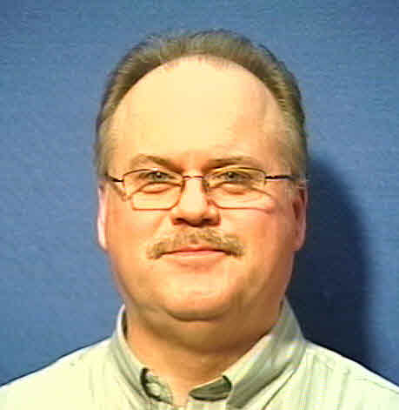
Ralph Johnson (U022189)
Corporate Tooling Manager
(Lisle)
331-332-3788
Victor Erickson (U01E822)
Tooling Analyst
(Lisle)
331-332-8365
NON METAL
METAL
CASTINGS
ELECTRICAL
Chris Koranda (U00CXKB)
Tooling Manager (Lisle)
331-332-7724
(Exterior Plastics)
Jim Tomlin (U01B545)
Tooling Manager (Lisle)
331-332-7283
(Stamping/Cab)
Craig Brelsfoard (U00CXBA)
Tooling Manager (TDTC)
331-332-1659
(Engine Components)
Dan Rowe (U01B571)
Tooling Manager (Lisle)
331-332-7725
(Electrical Components)
Jerry Steiner (U00JLSL)
Tooling Manager (TDTC)
331-332-4793
Composite/SMC/Fiberglass
Anthony Bell (U01E817)
Tooling Manager (Lisle)
331-332-3257
(Stamping Chassis/Frame)
Gene Hetrick (U023061)
Tooling Manager (Lisle)
331-332-7285
(Truck & Eng Components)
Robert Hug (U00RLHE)
Tooling Manager (TDTC)
331-332-2503
Interior Plastics /Rubber
SUPPLIER
Jim Felbinger (U01B954)
Tooling Manager (Lisle)
331-332-5440
(A/C Cooling Module)
TOOLING
ENGINEERING

Slide 7
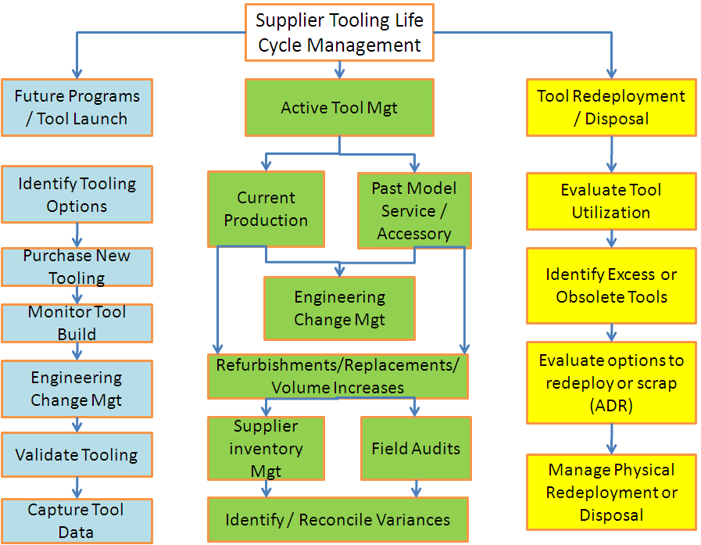
Supplier Tooling Scope of Responsibility

Slide 8
Updated Supplier Tooling Guidelines
Jerry Steiner
Supplier Tooling Manager

Slide 9
What are the Tooling Guidelines?
Definitions and qualifications for Supplier Based Tooling – SBT
Navistar requirements for Quoting, Purchasing, Construction, Repair, Etc. of Navistar funded tooling
Guidelines are periodically updated --Location:
http://www.navistarsupplier.com/SupplierTooling/SupplierTooling.asp

Slide 10
Supplier Tooling Guidelines - Summary of New or Revised Sections
What is Reimbursable Supplier Tooling-Updated
Tooling Refurbishment
Tooling Asset Identification
Tool Invoice Requirements
Submission of Tooling Photos
Tooling Transfer Process
Tool Inventory
Tool Cost and Audit Guidelines

Slide 11
Guideline Updates - Reimbursable Tooling
This section defines what types of tooling and tool related costs are paid by Navistar; and what costs are the suppliers responsibility.
A key item is that tool costs are a straight pass through of the actual cost incurred, a mark up on Navistar supplier tooling is not allowed.

Slide 12
Guideline Updates - Reimbursable Tooling
The Selected Tooling quote needs to be submitted on the current Tool Transparency form. (Backup quotes may be required separately)
A complete description of the tooling is needed on the Tool Transparency quote form; to determine compliance with the guidelines.
Please refer to the website to confirm latest guidelines and forms
In event of any question, please contact your Navistar Tooling Manager prior to quote submission

Slide 13
Updates - Tooling Refurbishment
Supplier is responsible for normal maintenance and repair for the quoted life of the tool
Replacement and Refurbishment is reimbursed within industry practice
Proactive communication is needed to allow adequate time for the Tooling Manager to obtain funding. This is accomplished with the Tooling Life Master (TLM) form
New Tool quote guidelines apply; (3) quotes, complete detail, etc.

Slide 14
Tooling Appropriation and Purchase Order Timeline
Tooling Refurbishment Timeline
Supplier/Tooling Manager
Purchasing Finance
Tooling Finance
Supplier
6
Weeks
4 Weeks
2 Weeks
13 Weeks
5/15
80 Percent
7
/
/201
2
6
27
/2011
/
29
/2011
8
/1
0
/2012
11
/
9
/2012
Tooling
Nearing
End of
Life
Validate
RFQ for
Validate
Validate
Submit
Appropriation
Obtain
Load
Create
Issue PO
Complete
CAD &
Refurbishment
Production
Cost and
Appropriation
Form Moves
Finance
Funding
PSTSAR and
to
Tooling
Part
Tooling
Requirements
Timing
for Tooling
through
Approval
Into
Approvals
Supplier
Refurbishment
Numbers
Refurbishment
Approvals
Funding
PeopleSoft
Based on
DOA
Begin
Timing
G
aps indentified:
Tooling
1.)
Supplier Proactive Communication
Refurb
2.)
Actual Tooling Refurbishment Lead
Time: 8 weeks
Compression cost based on requirements

Slide 15
Updates - Tooling Identification
All tools must be identified with Navistar Tool Tag Number which is provided on the tooling purchase order. This is different than the previous numbering system
Use the provided tool tag, stamp, engrave, or stencil as appropriate
Prominently and permanently mark “Property of Navistar” on the tool
CAT funded tooling will be identified per CAT guidelines

Slide 16
Updates - Tooling Invoice Process
Tooling Photo Requirement
Invoice process includes updated forms- the previous inventory form is replaced by the Tooling Acceptance Report
New address for invoice submission

Slide 17
Updates - Submission of Tooling Photos
Clear Pictures of the Tool(s) with a close up of the Tool Tag Numbers are required in the tooling invoice package
Pictures are to be named with the Navistar Asset Number provided as indicated in the Guidelines

Slide 18
Updates - Tooling Transfer Process
Any Tool Relocation requires notification to TM, SM, and SDM, prior to the move. (SREA is Required)
Tool transfers initiated either by Supplier or Navistar
A tool move will require a new Tooling Acceptance Report –TAR, provided to the Tooling Manager
Navistar is required to maintain accurate record of asset location

Slide 19
Updates - Tool Inventory
Expectations of Supplier Tool Inventory Activity:
Accurate Inventory will be maintained by suppliers, up to date with the detail forms provided by Navistar
Detail to include complete description, including physical attributes, digital pictures, CAD as requested
Deliverables:
TAR-Tooling Acceptance Report
TIM-Tooling Inventory Master

Slide 20
Updates - Supplier Record Retention
Purpose : Navistar reserves the right to validate any and all costs to determine whether tool charges are fair and reasonable, and to verify that records are accurate.
Suppliers are advised to maintain complete tool purchase documentation for all tooling for a period of two years from start of production.
Navistar may request and review these documents
within this time period.

Slide 21
When a Financial Tooling Audit is requested by Navistar
1.) Supplier receives a letter from Navistar requesting a
date for the Financial Tooling Audit.
2.) Navistar will submit a checklist of required
documents and details.
3.) Supplier will prepare the requested information for
each purchase order in question.
4.) Parties agree on timing of audit and set up a date

Slide 22
Information Required for the Audit
Original Navistar tooling purchase order, or a copy
Signed/completed TAR Form (Tooling Acceptance report)
3. Purchase orders issued to selected tool sources
Invoices & Quotes from tool sources
5. Lien Release if requested
6. Any related design change requests and costs
Tool quote for design changes
Copy of purchase order showing design changes
7. Proof of payment

Slide 23
Information required for the Audit - Cont’d
Tooling that resides at sub-suppliers is subject to this
tooling audit process.
All requested documentation needs to be ready for review
on the day of the audit separated by purchase order.

Slide 24
Guidelines URL Location
The guidelines and other tooling documents are available online at:
http://www.navistarsupplier.com/SupplierTooling/SupplierTooling.asp

Slide 25
SBTII Tooling Transparency (TT)
Craig Brelsfoard
Supplier Tooling Manager

Slide 26
What is a NAVISTAR TT ?
TT stands for (Tooling Transparency) which is a document supplied by Navistar to each of their tier 1 suppliers to fill in all required detail tooling cost information .
When submitted back to Navistar this will load the fields in to the Navistar PSTAR format which will start the P.O. approval process.
(See example next slide )
The TT form can be found on the Navistar Supplier website:
www.navistarsupplier.com/SupplierTooling/SupplierTooling.asp

Slide 27
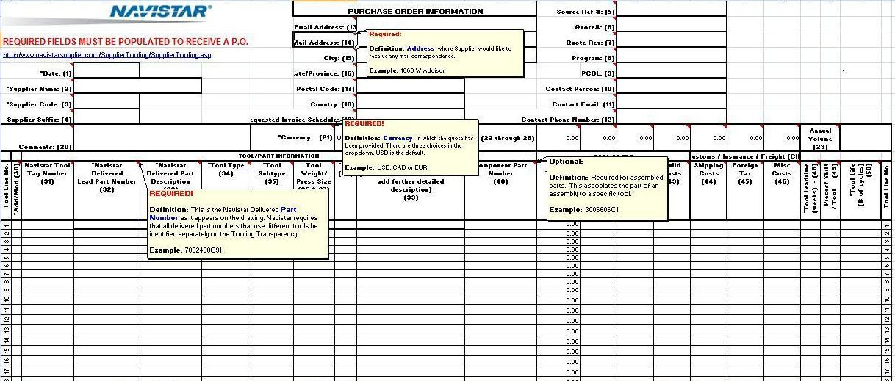
TT (Tooling Transparency) - Example
TT has Pop up help boxes to guide you through the required fields

Slide 28
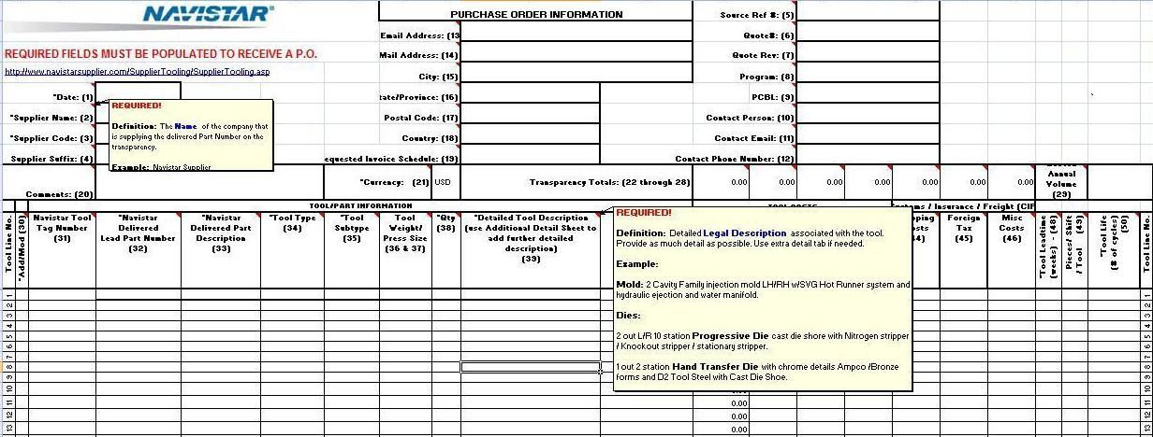
Header - Details of the TT
Purchase Order Information
Required Fields (Header)
Hover Over Instructions (Header)

Slide 29
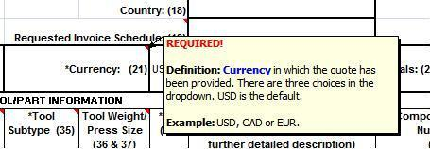
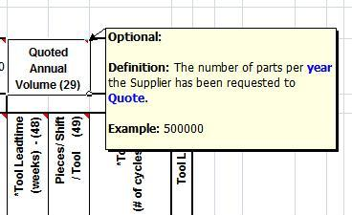
Header - Details of the TT
Currency (Cell 21)
Quoted Annual Volume (Cell 29)

Slide 30
Body - Details of the TT
Hover Over Instructions (Body)
Required Fields (Body)
Detailed Tooling Descriptions

Slide 31
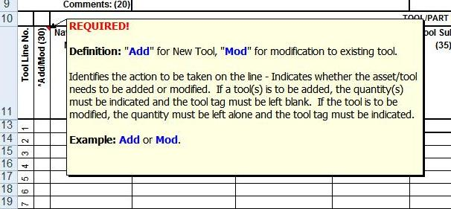
Body - Details of the TT
Add/Mod. (Cell 30)

Slide 32
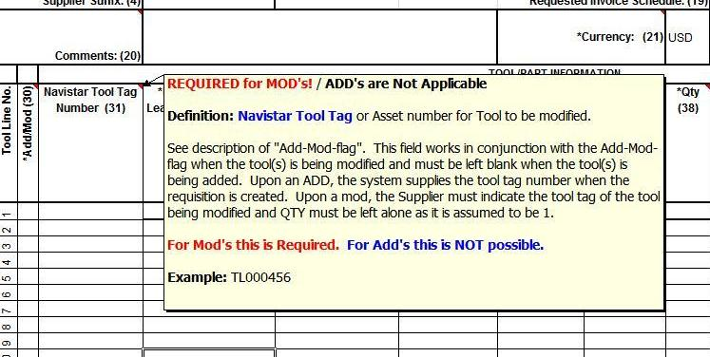
Body - Details of the TT
Navistar Tool Tag Number (Cell 31)

Slide 33
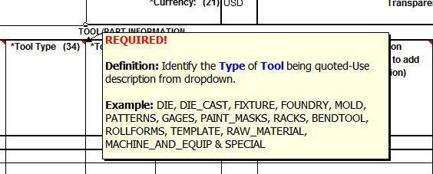
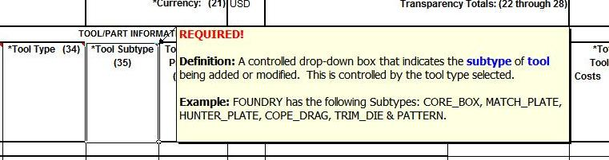
Body - Details of the TT
Tool Type (Cell 34)
Tool Subtype (Cell 35)

Slide 34
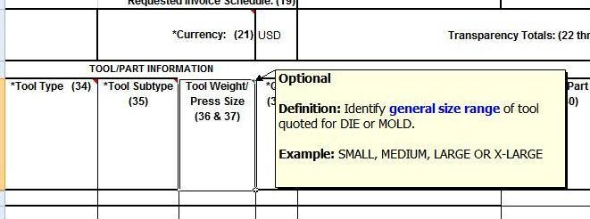
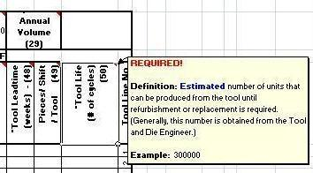
Body - Details of the TT
Press Size (Cell 37)
Tool Life Cycles (Cell 50)

Slide 35
FAQ’s -- TT (Tooling Transparency)
Q: Do I have to fill out all the fields on the TT before I can send it in to Navistar?
A: NO. The required fields are the only fields that need to be filled in.
Q: Can I get my P.O. if I do not submit the TT?
A: No. The TT form is required, then uploaded in order to generate the P.O.
Note: the TT form will be used for input to start the PSTAR system and must be supplied in Provided Excel format.

Slide 36
TAR (Tooling Acceptance Report) TIM (Tooling Inventory Master) Final Invoice Procedure Financial Request - Asset Verification Inventory
James Felbinger
Supplier Tooling Manager

Slide 37
The New TAR & TIM Documents
I would like to introduce the Newly Created TAR and TIM forms. These 2 forms will be used for the collection of Tooling Detail data and inventory asset management data from Navistar suppliers and their sub suppliers.
Note: collecting tooling inventory is not a completely new process to most of you. This is just an attempt to standardize the forms so that we all can benefit from the tooling information collected. This data will also integrate into our system for an automatic inventory management process.
The TAR’S focus is to effectively collect and record the Detailed Tooling Information related to each Purchase Order for tooling owned by Navistar.
The TAR will only have tooling details for a single Purchase Order.
The TIM’s focus is to effectively collect and record the Detailed Tooling Information related to All Tooling located at the tier 1 and there sub-suppliers for tooling owned by Navistar.

Slide 38
What is a NAVISTAR TAR ?
TAR stands for (Tool Acceptance Report) which is a document that shows in detail all tools, fixtures, and Gages as listed on a specific Purchase Order. (See example )
The TAR is designed to capture specific tooling details related to each P.O. and is required when sending invoice for final payment.
The TAR must be signed off by the Supplier and then submitted as part of the Final Invoice Package Submission.
TAR Form must be submitted in Excel format as provided.
The TAR process is scheduled to start on November 1st, 2012.
A blank TAR form can be found on the Navistar Supplier website:
www.navistarsupplier.com/SupplierTooling/SupplierTooling.asp

Slide 39
TAR (Tooling Acceptance Report) - Example
TAR has Pop up help boxes to guide you through the required fields

Slide 40
FAQ’s -- TAR (Tooling Acceptance Report)
Q: Do I have to fill out all the fields on the TAR before I can send it in to get final payment?
A: Yes. You will need to use the P.O. as reference to fill in all the required fields. Please match information from the transparency/P.O. to the TAR document. Then add all of the fields to complete each tool’s detail related to size, weight, and supplier locations.
(TAR must stay in the Excel format provided)
Q: Can I get my final payment if I do not submit the TAR?
A: No. you must submit the completed TAR form with your final invoice package.
Note: the TAR form will be ported into a database in the future.

Slide 41
FAQ’s --TAR (Tooling Acceptance Report) Cont’d.
Q: If I have a P.O. in process do I have to submit a TAR form with my final payment?
A: Yes. If there is a current P.O. in process and you have not submitted the final invoice by November 1st, 2012 , you will need to submit a TAR form with the details of your tooling to match the P.O.. (If you did not receive a pre-populated form – you will need to fill the TAR form in manually.)
Q: If I move a tool to a new production location, do I have to resubmit a TAR form?
A: Yes. Whenever a tool moves to a different production location the supplier must submit written notification to the Navistar Supply Manager,& Tooling Manager then submit a new TAR document along with updating the TIM document.
Q: What format should be used to submit a TAR?
A: The Navistar TAR form must only be submitted in the provided excel file format
in order for the form to be read into the Navistar Data Systems.

Slide 42
What is a NAVISTAR TIM ?
TIM stands for Tooling Inventory Master. Which is a list of all the tooling at a given tier 1 supplier or their sub suppliers, which they are responsible for. (see next slide example)
The TIM is the NEW standard format for Navistar suppliers to capture tooling inventory at their production locations.
Each supplier and sub supplier will have a number related to a production address listed on the header of the TIM (Tooling Inventory Master).
Each line item on the TIM will give all tools detail information, including part numbers and P.O. #’s, sizes and weights, along with production tool location number.
TIM form must be submitted in Excel format as provided.

Slide 43
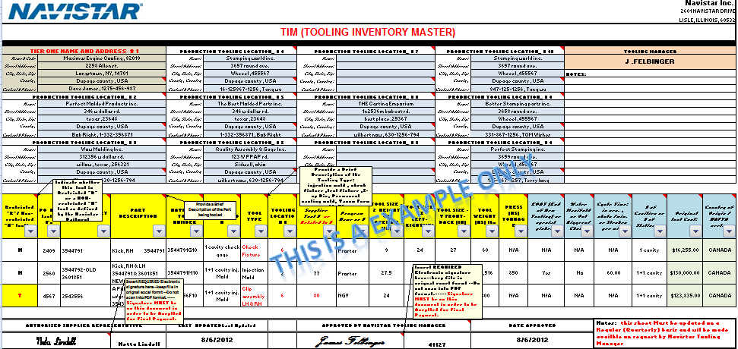
TIM (Tooling Inventory Master) Example
TIM has pop ups to help guide you through the required fields

Slide 44
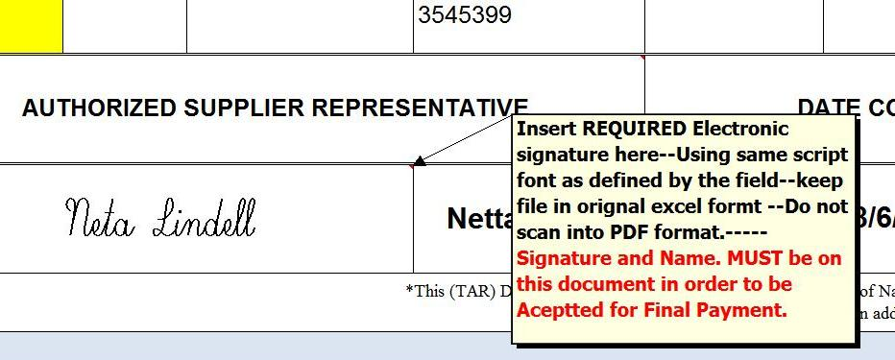
TAR & TIM Signature Requirements
Below is an example of the REQUIRED signature field on both the TAR and the TIM documents.(This field must be filled in before being submitted for final payment.)
THIS FIELD MUST HAVE THE TYPED IN SUPPLIER REPRESENTATIVES NAME
By using this excel file with a predefined font, just select the field and type in supplier representatives name in the left field and the standard text name in the right field.

Slide 45
TIM (Tooling Inventory Master) Cont’d.
90% of the required information for the TIM comes directly off the TAR form.
So the fields can be copied and pasted from the TAR to the TIM.
(Fields are lined up for this purpose on both forms,-- on next slide)
Supplier will populate the other required information when the tool is complete, or during the final payment stage.
This document should be kept up to date, (quarterly at minimum), and sent to the Navistar Tooling Manager upon request.
The TIM form can be found on the Navistar web site:
www.navistarsupplier.com/SupplierTooling/SupplierTooling.asp
The TIM form should be sent to Navistar in the provided Excel file format.

Slide 46
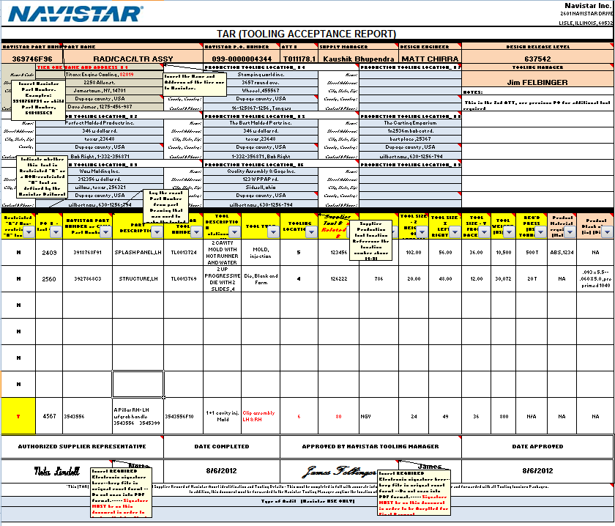
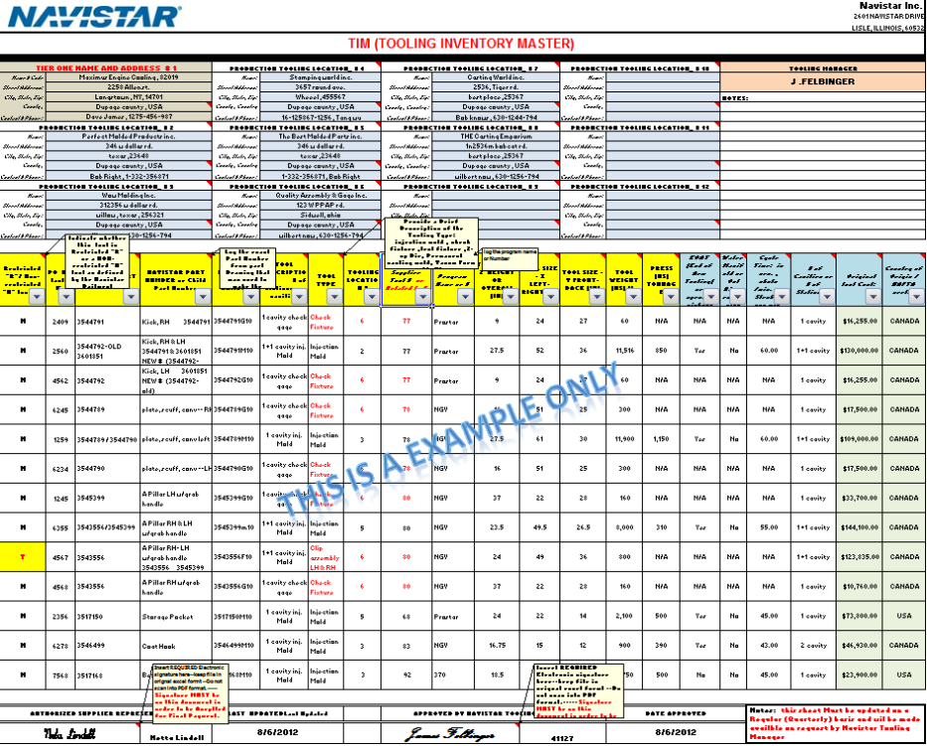
NAVISTAR TAR and TIM DOCUMENTS
TAR – Tooling Acceptance Report – standard supplier format for recording individual Navistar tooling inventory/per P.O. related to new the invoice procedure.
TIM – Tooling Inventory Master – New standard supplier format for maintaining Navistar tooling inventory.
Fields in yellow are a direct match to the Tim Form
Cut & Paste exactly

Slide 47
FAQ’s …TIM (Tooling Inventory Master)
Q: Will I have to submit a TIM with my final P.O. to get final payment?
A: No. You will only need to submit a TAR along with your final invoice package.
Q: Why do I need to fill out a TIM? When I have a TAR?
A: The TIM form is a complete comprehensive list of all tooling
that each tier 1 supplier and sub suppliers has, outlining all of the tool’s details.
The TAR is a record corresponding to a single P.O..
The TIM is used for legacy, current , and on future tooling inventory at the tier 1 suppliers and sub suppliers for Navistar’s quick reference, along with asset management.
Q: What about the Navistar tools that I already have in house, and have already been paid for before the November1st dead line? What steps do I need to take to get these tools on the inventory?
A: Tooling that has completed final payments (legacy) , will need to be included on the TIM form in order to complete a full inventory of the supplier’s tooling. This will be an ongoing process and we will need all supplier’s help to complete this task.
(see the tooling TIM time line)

Slide 48
Supplier Tooling Inventory Timeline

Slide 49
Purchase Orders and Responsibility
The following guidelines pertain to all Navistar tooling P.O.’s.
Tooling P.O.’s are issued from our Supplier Based Tooling group located in Lisle, IL.
Suppliers are responsible for the tracking and maintenance of Navistar-owned tooling.
Periodic audits of tools may be performed at tiered locations.
Asset tool tags are required and photo evidence must be provided as to whether the tools are properly tagged.
All tooling invoices and supporting documentation must be submitted as a complete package.

Slide 50
Final Invoice Overview
Contents of Typical (Final) Invoice Package
Invoice
Copy of Purchase Order
Signed Tool Acceptance Report (TAR) (see Tool Acceptance Report Procedure)
Signed Part Submission Warrant (PSW)= PPAP Approval
Pictures of the Tooling (within the guideline set forth for photo submission.)
(See photo requirements)
Additional Invoice Requirements
May also include tooling CAD files (upon request)
May also include Lien Release Letter (upon request)
Approvals
100 % Payment will only be made after the following two conditions are met:
Completed TAR requirements and TAR forms approved by Supplier & Tooling Manager
PSW is “Approved”
Other final payment approvals at the discretion of the Tool Manager.

Slide 51
Standard Invoice Requirements
Invoice packages should be submitted by Email unless otherwise directed
(File Size Limitations – Maximum # of pages {per attachment} 20
Maximum size {w/ attachments}: 10 megabytes)
Email is the Preferred Method
TAR forms must be submitted in Excel format as provided
Other files should be in PDF or JPEG format
Submit one electronic file containing all files except the TAR
Email Address: SBTAPSCAN@Navistar.com
All standard invoices should include:
Complete P.O. number (09900-xxxxxxxxxx)
Copy of the P.O.
Each invoice line item should indicate specific P.O. line item #
for each tool/payment combination
Description of the tooling for each line item
Delivered part number(s) and the Tooling Tag number
Only information from a single P.O. (do not combine multiple P.O.’s on one invoice)

Slide 52
Invoice Contact information
Final Invoice packages can be emailed to: SBTAPSCAN@Navistar.com
If there is a need to use another method you must contact :
Carlinda McGrew
Supplier Based Tooling Compliance Analyst
P: (331) 332-4781
Carlinda.McGrew@navistar.com

Slide 53
Final Invoice Requirements
Additional supporting documentation for final payment invoice includes:
Fully approved Part Submission Warrant (PSW) document
Completed Tooling Acceptance Report (TAR document) for all purchased tooling. This form can be found on the Supplier Website @ www.navistarsupplier.com/SupplierTooling/SupplierTooling.asp
CAT Tooling : same requirements as Navistar with (Exception of the CAT Tag and part Number).
Photo and Tag requirements see next Slide
All tooling invoices submitted on or after November 1st, 2012 will need to have a TAR submitted in the final invoice package for final payment.

Slide 54
Details for Final Photo’s & Tool Tags (Required for Final Payment)
Photo Criteria:
The Navistar requirement is: (2 pictures of each tool)
1) Close up of Navistar tag , showing “Property of Navistar” and Tag Number or same info stamped or engraved in tool (Numbers must be readable and a close up of the tag in the photo)
2) Picture of the overall tool plus any side views showing attachments, connections, or special features .
Picture file naming convention: TL0000386_1 (for the tag) TL0000386_2 (for the Tool)
Ideal picture of tool : Open tool position with associated piece part, also showing Navistar Tool Tag Number.
Tool Tag Number:
Tag must be permanently attached to the tool. If space does not allow or tool manufacturing conditions are not suitable for a tag, then stamp or engrave tool number on the tool itself.
Tag or tool must state “Property of Navistar” and have the assigned Tag Number from the P.O.
The Navistar tooling tag does not have to be used in all cases.
Any permanent metal tag can be used or the information can be machined, etched, scribed, stamped, etc., directly into the tool.
CAT Tooling : same requirements as Navistar with (Exception of the CAT Tag and part Number).
See tool tag and picture example on next slide……

Slide 55
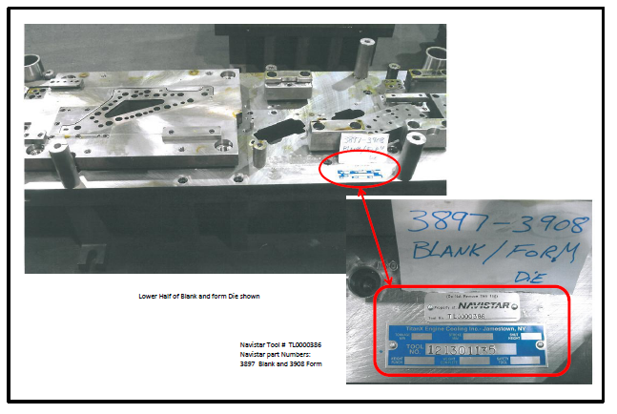
Tool and Tag Picture example-1

Slide 56
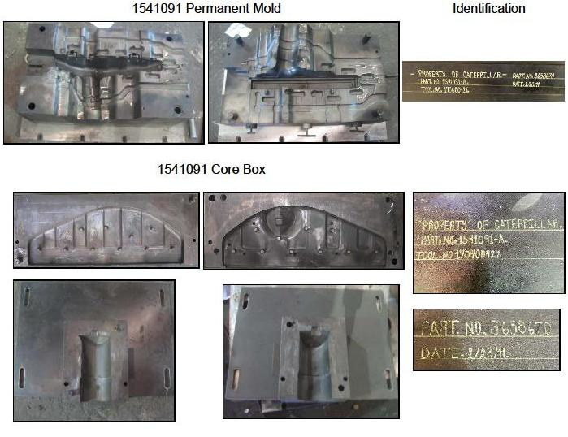
Tool and Tag Picture example-2

Slide 57
FAQ’s Invoice Requirements
Q: Can I submit the final invoice without the pictures and follow up later?
A: No. Pictures must be supplied at the time of final invoice and a compressed file is required. Preferred method is to create a single PDF file with labels. (Photo compression is required)
Q: Can I invoice without the Navistar or CAT tags in place?
A: No. There needs to be a Navistar tag or a
CAT tag. (For CAT tools) if not, the only other option is to stamp or
engrave – “Property of Navistar” or “Property of Cat”
on tools along with the tool number.
Q: Do I need to resubmit the PPAP for tool refurbishments or repairs?
A: Yes. Check with the SDM on the level of PPAP required.

Slide 58
Navistar Finance Request - Asset Verification of Inventory
Navistar has a current Urgent Request to validate our tooling assets that reside on our records for a sub-set of our suppliers.
A Direct Communication will be sent over the next week to the Suppliers that are required to respond to this Inventory Verification Request.
Included in this communication is: (1.) Letter from Navistar Management requesting your participation in this activity. (2.) The Asset Verification Maintenance Worksheet (AVMW) form our record of Tooling Assets that you are required to verify. (3.) The Instructions on how to complete your response back to Navistar.
The scope of this activity is a sub-set of our supply base. At this time only (25) suppliers are involved in this initial verification request.

Slide 59
Inventory Request - AVMW Form

Slide 60
Next Steps - Asset Verification Inventory
The Timing to complete your response back to Navistar is within Four Weeks from receipt of the Navistar notice.
Submit your completed AVMW form via email to the following address: SBTInventory@Navistar.com
Questions – Contact: Navistar Finance Manager, Todd Schwebke
Phone: 331-332-2873
Email: Todd.schwebke@navistar.com

Slide 61
TLM – Tooling Life Master Proactive Tooling Master Tooling Refurbishment
Chris Koranda, Gene Hetrick, Anthony Bell
Supplier Tooling Managers

Slide 62
TLM –Tooling Life Master – Form/Process
The TLM (Tooling Life Master) document is the form to provide an estimate of tooling refurbishment or replacement for the upcoming fiscal year.
The supplier is to recommend refurbishment needs based on tooling performance to ensure parts meet AAR approval.
The TLM captures the background information to adequately develop the business case to get funding approval for the refurbishment or replacement.
Suppliers are required to submit (3) competitive quotes to the Tooling Manager. This INITIATES the internal Navistar process to obtain funding.
Supplier is required to manage the TLM timing to get this through the Navistar approval process without incurring extra costs for expediting.

Slide 63
What is a NAVISTAR TLM ? (Tooling Life Master)
TLM stands for Tooling Life Master. This is a standard format for suppliers to utilize to communicate tooling life and potential tooling refurbishments requirements at either the tier 1 or tier 2 supplier locations. (see slide example)
Each supplier must submit the TLM process form prior to the end of Navistar’s fiscal year to the Tooling Manager only on tooling that will need replacement or refurbishment.
The TLM process form should be re-submitted at any time the supplier has identified a need for a refurbishment or replacement.
A new TLM process form would need to be submitted to address the requirements for any transfer tooling.
The TLM process must be submitted a minimum 12 weeks prior to PO issued.

Slide 64
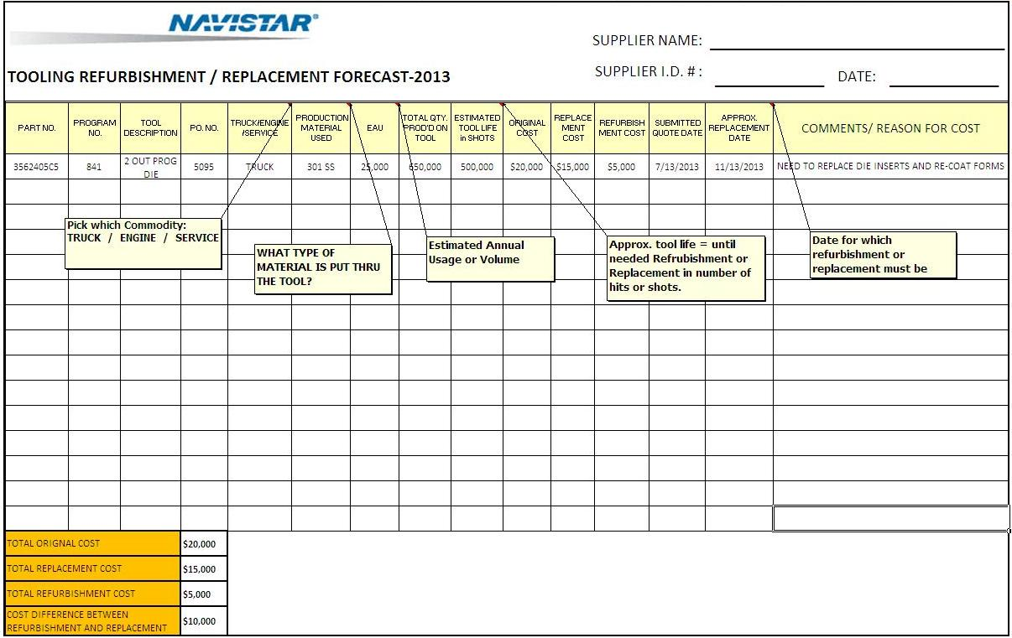
TLM (Tooling Life Master) Truck – Engine – Service Example
TLM has pop up to help guide you through the required fields

Slide 65
Proactive Tooling Management Timeline

Slide 66
FAQ’s …TLM (Tooling Life Master)
Q: When will I have to submit a TLM ?
A: It is suggested that the TLM be submitted prior to November 1 of each calendar year. Or, more importantly at any time that there are Tooling Refurbishments/Replacements that need to be communicated to Navistar to begin to track the timing.
Q: Why do I need to fill out a TLM?
A: The TLM is an early warning system that will allow Navistar and its suppliers the required time to prepare when a tooling refurbishment or replacement will be needed. That way, we both can all avoid unnecessary timing delays and cost.
Q: Where do I find the TLM form?
A: Our Navistar Supplier website:
www.navistarsupplier.com/SupplierTooling/SupplierTooling.asp

Slide 67
FAQ’s …TLM (Tooling Life Master)
Q: What timing is required by Navistar to Process a Tooling Refurbishment/Replacement?
A: Under normal circumstances it can take up to 12 weeks internally at Navistar to secure the funding to issue a purchase order to kickoff a refurbishment. (Overall Timing is considerably more).
Q: What starts the Navistar Refurbishment/Replacement Process?
A: When the Supplier forwards (3) competitive quotes to the Navistar Tooling Manager, this is the official notification to Navistar of the need to begin the appropriation process.
Q: What is Proactive Tooling Management?
A: This is the process whereby the supplier continually assesses the performance of its tooling inventory and communicates refurbishment needs to Navistar. This is to insure an uninterrupted supply of acceptable parts at no excessive cost.

Slide 68
Enhanced Tooling Bailment Agreement
Dan Rowe
Supplier Tooling Manager

Slide 69
What is a Bailment Agreement?
A Bailment describes a legal relationship in common law where physical possession of personal property is transferred from one person (the ‘Bailor’- Navistar) to another person (the ‘Bailee’ – Supplier) who subsequently holds possession of the property.
A Bailment Agreement is a legal agreement in which one person, the bailee, holds physical possession of a piece of property for another person, the bailor. For example, if you take your watch to a repair shop and leave it there for a few days, the repair person is a bailee in physical possession of your watch. The repair person does not own your watch but is holding physical possession for you.

Slide 70
Enhanced Tooling Bailment Agreement - Objectives
Mitigate Navistar and Supplier Risk by re-drafting current Bailment Agreement. Maintain maximum protection for both Navistar and our supplier interest to the fullest extent while at the same time minimize any associated cost.
Create a more user friendly Bailment Agreement that will be more easily understood without the need for Legal interpretation.
Utilize the new TIM (Tooling Inventory Master) process to serve as the official Inventory Record to capture the tooling Inventory that applies to this agreement at regular timing intervals.
Setup and document an internal process for the internal storage, retention and management for the signed Supplier Tooling Bailment Agreements.

Slide 71
Enhanced Bailment Agreement Timeline

Slide 72
Update Plan for Current Bailment Document
One Bailment Agreement now applies to all Navistar Tooling at Suppliers locations that does not expire
Capital/Expensed Tooling
Truck/Bus
Engine
Defense
Current Bailment Agreement
NEW
Non-Restricted Bailment
Agreement
(Standard)
NEW
Restricted Bailment
Agreement
(Proprietary)
Exhibit A, B
New Bailment Signed off as Part of New Business Proposal going forward
Notes:
TIM
Creates new document separate from Bailment to capture/record tooling inventory – TIM replaces Exhibit A,B
New Inventory Process
Tooling Inventory Master
TIM – Establishes a standard Navistar format and Inventory record for all Supplier Tooling to be applied to the Bailment Agreement
New Bailment Agreement captures specific language for Intellectual Property and Proprietary Tooling
Supply Manager

Slide 73
Bailment Agreement - Key Update Points
Update the Tooling Bailment Agreement – The New agreement streamlines the current content and deletes some of the unnecessary “legal ease” in an attempt to make the document more easily understandable.
The new agreement content has been reorganized into to a more logical series of details. (Agreements, Warranties, Consents, Miscellaneous.)
It also separates the tooling inventory list from the document. The new document applies to all tooling at a given supplier via supplier code which eliminates the need to continually resign agreements based on the attached inventory list of tools. The new process creates a finite number of supplier agreements to be signed.
Overall format reduction - First, there are two separate agreements one with standard language and one for proprietary information this reduced complexity. Secondly, several items have been moved to addendums to the agreement since they only come into play a small percentage of the time.
Based on 1 year of supplier language feedback many specific content requests have been adjusted to provide Navistar the correct liability coverage at no additional expense to our suppliers.

Slide 74
TIM (Tooling Inventory Master) Example
TIM has pop ups to help guide you through the required fields

Slide 75
Enhanced Bailment Agreement - Next Step Milestone Dates
1.) Supplier Informational Preview of New Bailment – 9/11/2012
2.) Sourcing Council Review to new Enhanced Bailment Agreement - 9/18/2012
3.) Rollout New Approved Bailment Agreement to Suppliers – 11/01/2012
4.) Enhanced Bailment emailed to all suppliers (Legacy tooling) - 11/01/2012

Slide 76
Frequently Asked Questions Tooling Summit Wrap-Up
Ralph Johnson
Corporate Tooling Manager

Slide 77
Supplier Tooling FAQ’s
1.) What Kicks-off Tooling? Truck and Engine?
The ATT authorizes Truck Suppliers and the PO authorizes the Engine Suppliers.
( Suppliers that receive an ATT and within a weeks time don’t get PO should contact us.)
2.) What is the Supplier Record Retention period for Tooling Purchasing Records?
A minimum of 2 years from the SOP date.
3.) What Internal timing is required by Navistar prior to Kickoff of Tooling Refurbishment?
This is usually 12 weeks that are required prior to tooling kickoff.
4.) Where do I find the TAR and TIM Documents?
Both these file formats are downloadable on the Navistar Supplier Website under
the Supplier Tooling Section. http://www.navistarsupplier.com/SupplierTooling/SupplierTooling.asp
5.) When does the TIM form for Navistar Tooling Inventory need to be completed?
All Suppliers are required to submit their complete tooling Inventory on the new
Navistar TIM form by March 1, 2013.

Slide 78
Supplier Tooling FAQ’s, Con’t
6.) Are there details as to how to submit tooling pictures to Navistar?
Yes, detailed instructions reside in the new Supplier Tooling Guidelines under Article 12 “Submission of Tooling Pictures”
7.) At what time should Navistar be informed of a Tooling location move?
Prior to any tooling relocation Internal or External The Navistar Tooling Manager, Supply Manager and Supplier Development Manager must be notified.
8.) How many tooling quotes are necessary for tooling valued at > $7,500?
To speed along the approval process 3 competitive tooling quotes are required to support all tooling transparency submissions.
9.) Where can I find what Navistar considers as Reimbursable Supplier Tooling?
The Navistar Tooling Guidelines, Sections 1 through 10 capture the details of what
is considered Reimbursable Tooling.
10.) Can I submit all the documents that are required for an Invoice package to Navistar as
a single PDF File. No, the TAR Form must be Electronically signed and submitted in the
provided Excel format.

Slide 79
Supplier Tooling Summit – Wrap Up
Individual Questions – Time Permitting
I believe this was a productive meeting today and we communicated what we needed to deliver. We certainly appreciate your questions during today’s Tooling Summit and at any time in the future as we look to hone in on our continuous process improvements.
Next up – To answer any more detailed questions you may have concerning any of the topics that were covered today please visit with the Tooling Managers at the Breakout Sessions
Thanks again for your participation. We look forward to making this a continuous series of meetings in the future.
As a Final Note this presentation and all the processes are posted to our Navistar Supplier Website (incl Audio). (Provided in your handout today)

