Slide 1
Escalation Management PLAYBOOK
SCIS & Command Center
2025
Notes:
Good morning! Thank you for joining us for this training session.
Let’s complete an introduction of 1) the training team & 2) participants
Here’s what to tell us:
Your Name
Your Role
How long you’ve been in your role
How long you’ve been at International
What you would like the outcome of this training to be
{Use post it notes to capture the outcomes the team wants – unless this is virtual then use mural or a separate PPT slide}
Now lets talk about logistics {when to expect breaks, lunch and what time will the training end}
Are we recording this? Will we send the deck out or where can they get a copy – is it in Spanish and English?
Next slide

Slide 2
03
Agenda
04
Training objective
INTERNATIONAL Way/core values
05
06
Meet the Teams
08
REACTIVE MANAGEMENT PROCESS OVERVIEW
Table of Contents
10
Training Exercises
18
MATERIAL PLANNING detailed escalation process
APPENDIX
26
SciS process escalation
28
Procurement Escalation process
DM
29
examples
Notes:
Good morning! Thank you for joining us for this training session.
Let’s complete an introduction of 1) the training team & 2) participants
Here’s what to tell us:
Your Name
Your Role
How long you’ve been in your role
How long you’ve been at International
What you would like the outcome of this training to be
{Use post it notes to capture the outcomes the team wants – unless this is virtual then use mural or a separate PPT slide}
Now lets talk about logistics {when to expect breaks, lunch and what time will the training end}
Are we recording this? Will we send the deck out or where can they get a copy – is it in Spanish and English?
Next slide

Slide 3

JR
Material planning Training – agenda
Introductions
Escalation Management Process Review
Break out groups/Complete exercises
Scenario #X
Read, discuss & answer questions
Regroup report out answers
Discuss as a group
Scenario #X
Read, discuss & answer questions
Regroup report out answers
Discuss as a group
Wrap Up:
Review deck/Q&A/Next Steps TIME PERMITTING
15 minutes
15 minutes
60 minutes
10 minutes
10 minutes
10 minutes
10 minutes
10 minutes
10 minutes

Slide 4
Escalation Management Process: Training objective
What is the expected outcome after the session?
Proposed message
- Present team and corresponding scopes
- Explain the escalation process
- Discuss examples of what to do and what not to do
- Open discussion for questions and suggestions
Support Needed
- Cascade message to entire material planner team
- Execute escalation process
dm

Slide 5
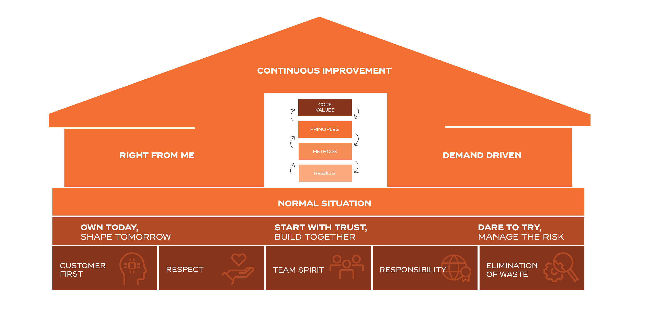
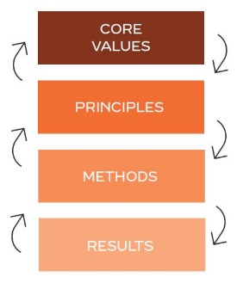
The international way
Meet the thinking model
DM
Notes:
Meet the Thinking Model.
The Thinking Model gives us a simple, logical path to connect our results to our values and to learn each step of the way.
When we use the thinking model, we’re intentional in considering who we serve and how we show up for them.
It helps us reflect, so we can constantly learn and improve, just like LEGO.
When we do this well, we solve problems that matter to our stakeholders in a way that:
Builds trust among us
Supports a stronger stakeholder experience, including for us, as employees, but also our partners across TRATON, our investors & shareholders, the environment, and most importantly, our customers.
Establishes standards that carry the company into the next 100 years and beyond.
The thinking model doesn’t work on its own.
We have to practice every day and feel its benefits.
In order to do that, let’s take a closer look at each piece now.

Slide 6











Supply Chain (SCIS) Team
Dave McCall
Supply Chain Associate Director
MAIN RESPONSIBILITIES
Address new MMARs / SAI(s) received within 2 hours of assignment within business hours
Understand supplier part delivery requirements to meet POA dates
Be proactive addressing any potential issues to avoid POA
Lead meetings, remain involved with stakeholders to address issue outlined in MMAR
Work with supplier on recovery plan back to EDI
Proactively follow up on MMAR until issue closed/resolved
Utilize MMAR escalation/de-escalation process as necessary
Joe Ruge
Supply Chain Manager
Candy Amaro
SCIS Supervisor
Gate Keeper
Myrna Pierantoni-Rivera
Supplier Collaboration
Mai Ndiaye
SCIS Member Corrective Actions
Kathryn Kolinski
SCIS Member
William Gieske
SCIS Member
Ashley Mackey
SCIS Member
On-Site Support
Ops Support /Corrective Action/On-Site Support
Cabin/Electrical
Chassis
Cabin/Thermal
Supplier Collaboration
Michael Thomas
SCIS Member
Pam Pozos
SCIS Member
Shaq Alexander
SCIS Member
Open
Chassis/Body Systems
Wiring
Find the most effective way to ensure we have the right parts,
at the right place, at the right time for our customers (manufacturing plants) at all times.
Mission:
CA
SCIS = Supply Chain Improvement Services

Slide 7
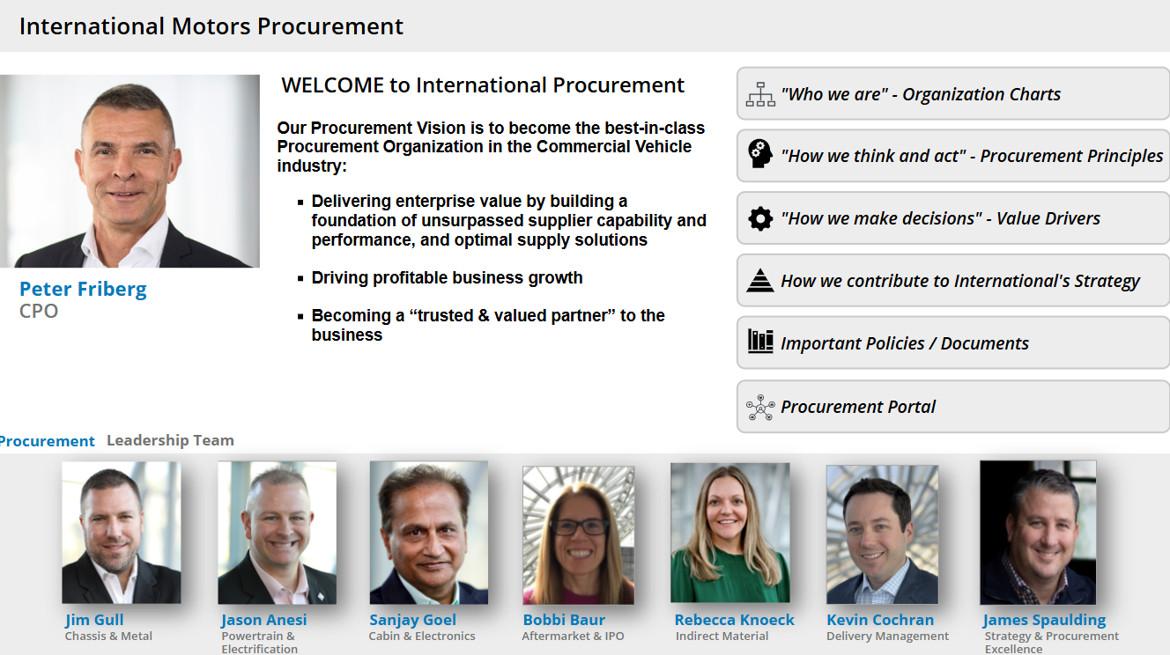






Command Center (CC) Team
Kevin Cochran
Delivery Management
DIrector
MAIN RESPONSIBILITIES
Root Cause validation for escalated cases
Interim Corrective Action (ICA ) and Permanent Corrective Action (PCA )identification and tracking
Reduction of Expedited Freight and POA impacts
Lead onsite support for short term impacts
Cheryl Berklich
Sr. Mgr Supply Continuity
Command Center
Luis Gonzales
Supplier Development
Jesse Rivers
Command Ctr Mgr
Powertrain
Askar Salman
Command Ctr Mgr
Cabin/Electrical
Victor Ramirez
Sr. Command Ctr Mgr
All Towers & On-Site supt
Luis Quiroga
Supplier Development
Antonio Ponce Command Ctr Mgr
Chassis/Harnesses
Osiris Torres Command Ctr Mgr
Chassis
Our goal is to assure a sustainable source of supply for continuous service & production of International trucks, buses, and engines.
Mission:
cb

Slide 8




Reactive Delivery Management Escalation: Area of Responsibility
1
2
3
4
5
6
Planner
SCIS
Command Center
Commercial
Logistics
Procurement
Supply Disruption / Risk
Escalation
Escalation
Leadership Engagement
Define acceptable Supply Plan - Short term
Request alternate ship plans
Secure Transportation and material tracking along the duration of the escalation
Internal plant caused issues
Buffer / Safety Stock Strategy
Pre Job 1 <90 day working with program teams
Communication / Inflexibility of Supplier
Demand / Schedule / ASR (Automated Shortage report)
Transportation / Logistics issues
Containerization problems
Cross functional issues management (Engineering, OTD [ORDER TO DELIVERY], IT, etc.)
Temporary capacity constraints
Ongoing Program issues after 90 days post job 1
No satisfactory recovery plan defined
Ongoing Communication / Inflexibility of Supplier
Capacity / allocation constraints (including sub tier restrictions)
Commercial issues
Labor constraints
Raw Material Shortages
Onsite Support
> 30 days without progress per recovery plan (depending on severity
Commercial negotiations (pricing, payment, capacity, allocation)
Sourcing needs
Tooling / capital investment requirements
Resource Systems:
Control tower tools
ISCV
Killer Bee
ISCV
Killer Bee
Supply – Demand / EES
Control tower Tools
ISCV
ISCV
Notes:
Everything begins with a supply disruption which causes a risk to the Plant to get parts, either the supplier can’t, or won’t provide parts
We’ve listed, general, areas each team manages
On the Logistics side, you can see what may cause a disruption – there are of course of events that cause disruption, but these are the primary causes
Then we move to escalation, and you’ll see again on the Logistics side of the equation what the SCIS manages with out escalation

Slide 9
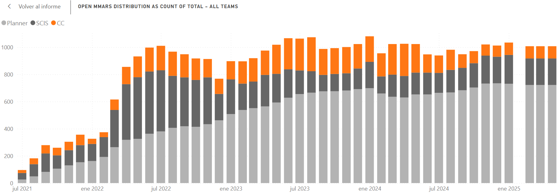
DM
ESCALATED CASE DISTRIBUTION
Ensure all newly escalated cases are properly managed from creation date to event closure.
2025 KPI
CC team
SCIS team
Material planning team
Quantity of cases escalated to either SCIS and/or COMMAND CENTER (new KPI)
Target for 2025 = 136 avg cases per month across both SCIS and COMMAND CENTER
Permanent corrective action, monitoring and continuous improvement initiatives reduce overall cases

Slide 10
VR
scenarios

Slide 11
Exercise instructions:
Material planning – training exercises
For these scenarios, please review and provide your best response to the following questions:
What are the actions, in order, that you would take to resolve this situation quickly?
At what point would you decide to escalate and why?
To whom would you escalate? Who would you expect to escalate to other then your Supervisor?
What information would you need to provide to the person you’re escalating to?
JR

Slide 12
Scenario 1: ship hold due to a freight debit
Material planning – training exercises
You received an email or phone call from a supplier saying that they won’t ship expedited until we reverse recent expedited freight debits issued by the Plant.
Questions
What are the actions, in order, that you would take to resolve this situation quickly?
At what point would you decide to escalate and why?
To whom would you escalate? Who would you expect to escalate to other then your Supervisor?
What information would you need to provide to the person you’re escalating to?
JR

Slide 13
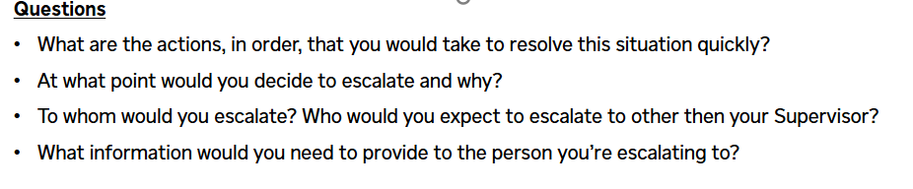
Material planning – training exercises
Scenario 2: no root cause
As the Material Planner, you received an email on Monday, January 27th, from a Supplier saying they’re not going to meet next week’s MRD (Sunday February 2nd), they did not share root cause or a delivery date. If the Plant does not receive this material on time, it could cause an impact.
JR

Slide 14
Scenario 3: COMPLEX, MULTIPLE ROOT CAUSES
Material planning – training exercises
You received an urgent email from a supplier saying that they have a tool that is broken and a tier 2 component shortage. It will take four weeks to repair, and they are working with the Tier 2 to determine when they will be able to ship – looks like they won’t receive parts for at least 4 days. This will cause a line down situation at the Plant in 2 days.
JR

Slide 15
Scenario 4: International Inventory Adjustment (lost material)
Material planning – training exercises
You are notified by the Material Team that on a specific part the cycle count differs from the system, and they are making an inventory adjustment. You’ve contacted the supplier and already worked out a Best Ship Date and negotiated the break-in fee with no room for improvement.
JR

Slide 16
Scenario 5: Supplier no longer producing part
Material planning – training exercises
You are notified by the Supplier that they will no longer be producing a part for International and will use up current inventory only.
JR

Slide 17
DETAILED ESCALATION PROCESS

Slide 18




Level 1 Planner | Main activities
1
2
3
4
5
6
Planner
Planner Escalation
SCIS
SCIS
Escalation
Command Center
Command Center Escalation
Commercial
Questions to address
ERP (LN, BaaN)
Official Portal
Killer Bee
MS Teams (repository)
What to do when a supply disruption is identified?
How to internally escalate a situation?
How a MMAR and / or SAI is generated in the system?
Sources
Main activities to execute:
Responsible for:
Supplier
Communicate supply disruption
Provide detailed explanation of when, why and magnitude of the identified impact to International
Review EDI830 and line set exception reports to identify risk
Use the TADA system to review alternative ship plans
Use the TADA system to generate a new MMAR
Pull EDI history from Power BI reports and review with supplier
Modify EDI parameters to align with Supplier
Add shipments to Ryder and execute RXO application
Check PDC and sister plants for available inventory
Have engineering look for a substitution
Negotiate a break-in fee with the supplier
Collaborate with Supply Manager for contract issue revisions
Move the escalation to step 2 / 3 in the TADA system
Responsible(s)
Monitor supplier shipments to satisfy demand
Work with supplier for potential supply risk analysis
Issue an escalation event when there is a risk of impact
Review EDI to determine corrective actions
Expedite shipments when applicable
Find alternative part supply via the checklist
Issue P.O. to pay break-in fee if required
Work through contract / source change / PUR issues
Escalate the event to level 2 if no identified solution
Planner
NOTES
None
JR
MMAR definition: Manufacturing Material Action Request
SAI definition: Supplier Action Item
EDI 830 definition: Material procured by MRP processes
EDI 866 definition: Material procured using job sequence

Slide 19
Level 1 Planner | types of escalations
1
2
3
4
5
6
Planner
Planner Escalation
SCIS
SCIS
Escalation
Command Center
Command Center Escalation
Commercial
Questions to address
Control Tower Tools
Official Portal
Sources
What type of escalations are available in the system?
How to enter correctly an escalation event?
Type of escalation events
Part related escalation require either 830 MMAR (part number) or 866 MMAR (job level) event
➔ Up to maximum 10-part numbers
Add all impacted part numbers (if more than 10 parts should issue a SAI escalation event).
Complete the pre-MMAR checklist.
Complete Issue Description in full (include all details available), Correct severity and accurate POA date.
Supplier contact information (who has already been contacted)
Copy and paste supplier email in Internal MMAR Messages or attached PDF version of E-mail.
Allows for attachment of Excel files to MMAR or Internal MMAR messages.
Determine Root Cause with supplier and specify it into the system (Please do not use 05 Supplier Behind).
Specify what SCIS support is needed in the escalation event (How can we help?).
For 866MMARs, include child part number (not just job numbers) to help assign to the proper case owner
Planner
Responsible(s)
Planner Supervisor
If a part related escalation event is not created under the correct replenishment type (either 830 or 866), the escalation will not proceed and will be de-escalated back to the originator for proper tracking
LN ERP data is now implemented in TADA therefore STX /HEP / Insourcing should use 830MMARs, 866MMARs and /or SAIs.
NOTES
JR

Slide 20
Level 1 Planner | Types of escalations – (c0nt’d)
1
2
3
4
5
6
Planner
Planner Escalation
SCIS
SCIS
Escalation
Command Center
Command Center Escalation
Commercial
Questions to address
Control Tower Tools
Official Portal
Sources
What type of escalations are available in the system?
How to enter correctly an escalation event?
Type of escalation events
Non-part related escalation require SAI event (supplier level action request) or impacting more than 10-part numbers
➔ Force Majeure, Tooling down, Capacity
Complete the pre-MMAR checklist.
Complete Issue Description in full (include all details available), Correct severity and accurate POA date.
Supplier contact information (who has already been contacted)
Ensure type of issue is properly described in the MMAR (Force Majeure, Tooling down, Capacity, etc.)
Copy and paste Supplier E-mail in Internal Messages or attach PDF of E-mail to the MMAR or SAI.
Attach Excel file to SAI or Internal messages.
Determine Root cause with Supplier and specify it into the system (Root Cause can change).
Be specific in regards what SCIS support is needed in the escalation event (How can we help?).
Planner
Responsible(s)
Planner Supervisor
If a part related escalation event is not created under the correct replenishment type (either 830 or 866), the escalation will not proceed and will be de-escalated back to the originator for proper tracking
For STX / Insourcing if unable to enter 830MMAR you must add part number to a SAI event.
NOTES
JR

Slide 21
Level 1 Planner | Escalation event required
1
2
3
4
5
6
Planner
Planner Escalation
SCIS
SCIS
Escalation
Command Center
Command Center Escalation
Commercial
Questions to address
Control Tower Tools
Official Portal
Sources
When is a MMAR / SAI required?
When to create a MMAR (830,866) / SAI ?
Supplier backlog with no ship recovery plan communication
Communication of upcoming disruption (Tier 2 item shortages, machine down, etc.)
Foreseen external situation that will impact supply (weather, socio political, mother nature, etc.)
Planner identified a risk that don’t have a plan to protect the plant
Commercial Issues are to be resolved working with Supplier Manager and escalated up the procurement chain of command – see appendix for organizational flow (Examples: Credit holds, contract issue, X-code issues, incorrect supplier codes, pricing, etc.)
If force majeure letter is communicated from supplier (i.e. tariffs, external situations) then communicate to Procurement Command Center team (cheryl.berklich@international .com) and Procurement Risk Management team (sara.spring@international.com)
Supplier
Responsible(s)
Planner
Fields in TADA are mandatory, but the data quality and input is strongly dependent on the Planner. Poor information will cause additional communication and clarification effort in a process that requires high velocity.
Planner supervisor is responsible to ensure the quality of the information contained in the escalation event before submitting (830MMAR, 866MMAR, SAI) to a higher level.
Fields in TADA are mandatory, but the data quality and input is strongly dependent on the Planner. Poor information will cause additional communication and clarification effort in a process that requires high velocity.
Planner supervisor is responsible to secure the quality of the information contained into the system escalation event submitted (830MMAR, 866MMAR, SAI) to a higher level.
NOTES
JR

Slide 22
Level 1 Planner | Planner checklist
1
2
3
4
5
6
Planner
Planner Escalation
SCIS
SCIS
Escalation
Command Center
Command Center Escalation
Commercial
Questions to address
Control Tower Tools
Official Portal
Sources
What steps does a planner need to execute before submitting an escalation event?
Steps to complete prior to submitting an escalation event:
Identify risks (risk within 10-day time frame)
Contact supplier via phone or email to identify root cause
Obtain supplier ship plans / resolution to protect the plant
Check supplier ship plans in TADA – Acknowledge them via system
Look for Help outs in other International plants Plants / PDC / Dealers
For a denied PDC help-out, engage Planner supervisor for support
Look for substitutions using plant Engineering contacts .
Look for previous revision levels, substitutes and deviations used.
Responsible(s)
Planner
Checklist help-out step is not a one-time only activity, this need to be executed several times along the escalation event as material may be available at previous searched locations; planner is the responsible to deliver mitigation plans by usage of help-outs.
TADA offers a checklist which needs to be updated and properly used by the time the escalation event is entered.
NOTES
JR

Slide 23
Level 1 Planner | Escalation event not needed
1
2
3
4
5
6
Planner
Planner Escalation
SCIS
SCIS
Escalation
Command Center
Command Center Escalation
Commercial
Questions to address
Official Portal
Sources
When is an event not required to be escalated?
Events requiring no escalation:
If there is a plan already in place with no room for improvement.
Inventory adjustment (International plants) with Best Ship Date communicated and break-in fee applied.
For Product Launches contact Purchasing Program Manager (PPM).
For Commercial issues (contract issue, force majeure, X-code issues, incorrect supplier codes)
➔ Contact Supply Manager as first level contact
For Corporate POs (Tier II expedite freight / commercial negotiation / payment in advance)
➔ Contact Supply Manager as first level contact
MMARs / SAIs (ie. Insourcing, CAS) specific to internal plant issues only.
Transportation / logistics issues related to Ryder and / or RXO.
Supplier over ships parts without requirements.
Planner
Responsible(s)
Planner Supervisor
Planner is expected to contact procurement Supplier Manager if escalations can be directed to specific issues that do not need to be triangulated with either a SCIS and/or a Command Center resource.
Link to identify corresponding program PPM contact to address International Product Launch escalations:
https://Internationalinc.sharepoint.com/:x:/t/PPMPMOOrganization/EdSjFVpDzz9GtLHoZzpwkloBiBo7BaQimoe-DHm3oLCgQQ?e=0vNVqV
NOTES
CB

Slide 24

Level 2 Planner Escalation | Main activities
1
2
3
4
5
6
Planner
Planner Escalation
SCIS
SCIS
Escalation
Command Center
Command Center Escalation
Commercial
Questions to address
Control Tower Tools
Official Portal
Killer Bee
Power BI
MS Teams (repository)
Sources
How to escalate a situation to SCIS team?
What requirements are needed to escalate a MMAR / SAI?
Main activities to execute:
Responsible for:
Supplier
Provide required information to explain cause of disruption
Attend and participate in meetings
Communicate the impact timing
Look at EDI to determine corrective actions
Set up any required transportation
Relay status to plant staff
Planner updates the impact timing as necessary
Pull EDI history from Power BI reports and review with supplier
Adjust EDI parameters as required to right size buffers
Provides shipping needs to Ryder and RXO
Attend and participate in meetings
Responsible(s)
Planner
Planner Supervisor
Reviews MMAR
Advises Planner on other potential options to mitigate risk
Determines if escalation is required
MMAR is checked in TADA to ensure all required info is entered
Ensure MMAR documentation is clear and concise
Meeting with planner to ensure all plant resources have been used
Move the MMAR to level 3 in the TADA system if no solution can be found
NOTES
It is the responsibility of the planner supervisor to review the MMAR for completeness prior to escalating to step 3
CA

Slide 25
Level 2 Planner Escalation |
1
2
3
4
5
6
Supervisor
Checklist
Planner
Planner Escalation
SCIS
SCIS
Escalation
Command Center
Command Center Escalation
Commercial
Questions to address
Control Tower Tools
Official Portal
Sources
How to ensure that escalation events successfully transition to the next higher level (with no risks for de-escalation)?
Steps to exhaust prior to submitting an escalation event
Verify all information included in the MMAR / SAI is complete and accurate
Confirm execution of planner checklist
If encountered a PDC help-out rejection, then engage into an escalation:
Planner supervisor to contact International service manager to communicate the urgency / severity of the situation while offering a payback plan for requested material
Planner supervisor responsible to follow up the payback promise upon the PDC help-out
Verify with planner shipment status and already defined shipping plans to identify additional risks or coverage
Responsible(s)
Planner Supervisor
Planner supervisor checklist is not in the system, but its critical to secure the most accurate and complete information to the following escalated levels
International service manager contacts,
Robert Walsh: Robert.Walsh@international.com
Scott Mcconnell: scott.mcconnell@ international.com
NOTES
CA

Slide 26
Level 3 SCIS | Main activities
1
2
3
4
5
6
Planner
Planner Escalation
SCIS
SCIS
Escalation
Command Center
Command Center Escalation
Commercial
Questions to address
ISCV
Killer Bee
MS Teams (repository)
Sources
What is being done by the SCIS team when an event is escalated (level 3)?
Main activities to execute:
Responsible for:
Planner updates the impact timing as necessary
Pull EDI history from Power BI reports and review with supplier
Adjust EDI parameters as required to right size buffers
Provides shipping needs to Ryder and RXO
Attend and participate in meetings
Communicate the impact timing
Look at EDI to determine corrective actions
Set up any required transportation
Relay status to plant staff
Planner
Responsible(s)
Engage higher level supplier contacts
Contacts quality, engineering, and tooling teams as required
Set up regular conference calls
Look for break in fee, help-out, or substitution
Plot out demand and supplier recovery timing to understand if the issue is long or short term
Escalate within the supplier´s organization
Engages support teams
Establish meeting cadence with supplier
Rework the checklist
Establish recovery date
SCIS
NOTES
It is expected to have the planner always engaged with SCIS lead to execute main planning activities
CA

Slide 27
Level 4 SCIS Escalation | Main activities
1
2
3
4
5
6
Planner
Planner Escalation
SCIS
SCIS
Escalation
Command Center
Command Center Escalation
Commercial
Questions to address
ISCV
Killer Bee
MS Teams (repository)
Sources
When to escalate an event above level 3?
What steps are required to escalate to the Command Center team (level 5)?
Main activities to execute:
Responsible for:
Communicate the impact timing
Look at EDI to determine corrective actions
Set up any required transportation
Relay status to plant staff
Planner updates the impact timing as necessary
Pull EDI history from Power BI reports and review with supplier
Adjust EDI parameters as required to right size buffers
Provides shipping needs to Ryder and RXO
Attend and participate in meetings
Planner
Escalate within the supplier´s organization
Engages support teams
Establish meeting cadence with supplier
Rework the checklist
Establish recover date
Engage higher level supplier contacts
Contacts quality, engineering, and tooling teams as required
Set up regular conference calls
Look for break-in fee, help-out, or substitution
Understand demand and supplier recovery timing
Responsible(s)
SCIS
SCIS Manager
Review recovery timing for acceptability
Confirms root cause and constraints
Moves MMAR to level 5 in TADA if recovery is unacceptable
Communicates issues with command center
NOTES
None
CA
Notes:
This is the last slide in the initial escalation process training
Victor - This has to be part of the core initial presentation (process)

Slide 28
Level 5 procurement| Main activities
1
2
3
4
5
6
Planner
Planner Escalation
SCIS
SCIS
Escalation
Command Center
Command Center Escalation
Commercial
Questions to address
ISCV
Killer Bee
MS Teams (repository)
Sources
What steps are executed once an escalation event is risen to Command Center team (level 5 & 6)?
What happen after level 6 step?
Main activities to execute:
Responsible for:
Command Center Gate Keeper
Receive events escalated by Planner and SCIS teams
Identify escalation type
Assign escalation event to a Command Center Manager (< 24 hrs)
Monitor escalation event progress
Validate if the event is ready for De-Escalation
Daily review in ISCV for escalated events to CC Gate Keeper
Review Command Center workload
Elaborate and send communication letters to supplier executives
Communicate and review progress of escalations
Communicate metrics
Receive hand off from planner / SCIS team
Evaluate impact
Engage into on-going communications with supplier
Escalate to supplier executive team
Confirm Root Cause
Implement Interim Corrective Action (ICA) and Permanent Corrective Action (PCA)
Define Recovery date
Escalate to procurement leadership as needed
Update case file in MMAR / SAI in TADA
Analyse Root Cause by using 5Why template
Create Supply and demand chart to identify exact impact and recovery date
Create 30-60-90 action plan with supplier
Engage supporting areas to drive specific event requirements
Responsible(s)
Command Center Manager
Planner
Communicate the impact timing
Set up transportation
Relay status to plant staff
Support all meetings and production visibility required
NOTES
It is expected to have the planner always engaged with Command Center lead to execute main planning activities
CB
Notes:
This is the last slide in the initial escalation process training
Victor - This has to be part of the core initial presentation (process)

Slide 29
Escalation event Examples

Slide 30

Level 1 Planner | Escalation event required – CONTRACT & PAYMENT ISSUES
1
2
3
4
5
6
Planner
Planner Escalation
SCIS
SCIS
Escalation
Command Center
Command Center Escalation
Commercial
Questions to address
BaaN
PeopleSoft
Has the Supply Manager been notified first?
Is the Supplier stopping shipment(s)?
Can they provide the invoices and bill of lading in question?
Sources
Requirements for Contracting/Pricing/Payment Issues:
Notifies Material Planner of payment, contract/pricing and/or stop ship
If payment issue, provides copies of all unpaid invoices & BOLs
For payment issues, the Supplier should also be contacting the AP mailbox for assistance
If Contract / Pricing issue, provides email support for notification
Supplier
Payment issue:
Confirm parts have been received in, if so, contact Supply Manager noted in BaaN with all copies of invoices & BOLs
If parts have not been received in, notify receiving – parts must be received in, so the system knows to pay the supplier
For EAP, after confirming the parts are received in, contact Plant Accounting to advise them the Supplier has not been paid and request them to release payment. If the parts have been received in, contact Plant Accounting to have them determine why the Supplier hasn’t been paid.
Contract / Pricing issue: Provide email support from the Supplier and contact the Supply Manager via email and IM to notify of the issue needing correction
Responsible(s)
Planner
NOTES
If Material Planning needs assistance identifying the assigned Supply Manager reach out the Command Center
For both issues the escalation path in Procurement is through the Supply Management Teams (see Appendix for Escalation Org chart, slide 55)

Slide 31
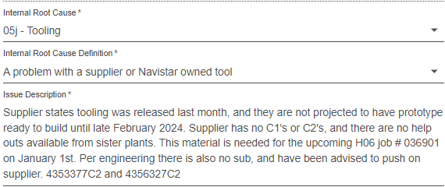
Level 1 Planner | No escalation needed (cont.)
1
2
3
4
5
6
Planner
Planner Escalation
SCIS
SCIS
Escalation
Command Center
Command Center Escalation
Commercial
Questions to address
Control Tower Tools
Official Portal
Sources
Which scenarios do not require escalation?
Program launch
Example:
Planner
Responsible(s)
Planner Supervisor
NOTES
MMAR is not needed. Please work directly with the program manager
Link to identify corresponding program PPM contact to address International Product Launch escalations:
PPM Contact List

Slide 32
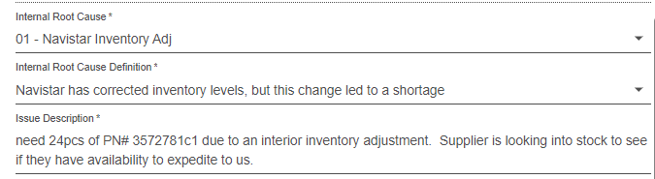
Level 1 Planner | good Escalation event
1
2
3
4
5
6
Planner
Planner Escalation
SCIS
SCIS
Escalation
Command Center
Command Center Escalation
Commercial
Questions to address
Control Tower Tools
Official Portal
Sources
What is considered a good escalation event?
Inventory Adjustment MMAR has part number and quantity needed
Example:
Planner
Responsible(s)
Planner Supervisor
NOTES
None

Slide 33
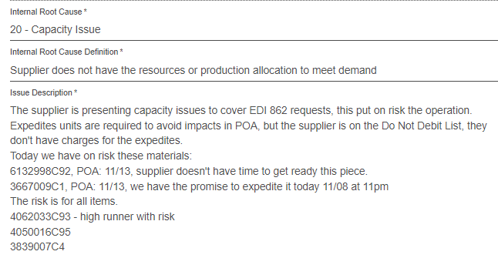
Level 1 Planner | Good escalation event (cont.)
1
2
3
4
5
6
Planner
Planner Escalation
SCIS
SCIS
Escalation
Command Center
Command Center Escalation
Commercial
Questions to address
Control Tower Tools
Official Portal
Sources
What is considered a good escalation event?
Capacity Issue
Example:
Planner
Responsible(s)
Planner Supervisor
NOTES
None

Slide 34
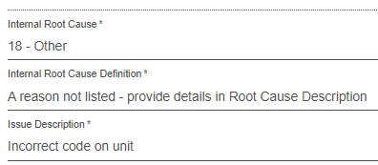
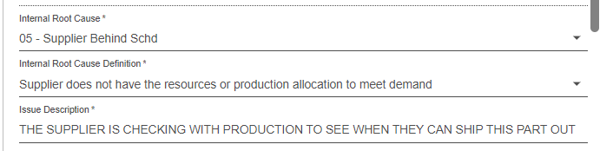
Level 1 Planner | Bad escalation event
1
2
3
4
5
6
Planner
Planner Escalation
SCIS
SCIS
Escalation
Command Center
Command Center Escalation
Commercial
Questions to address
Control Tower Tools
Official Portal
Sources
What is considered a bad escalation event?
Not enough information – What SCIS / CC support are you asking for?
Example:
Example:
Planner
Responsible(s)
Planner Supervisor
NOTES
We no longer use “Supplier Behind Schedule” or “Other”

Slide 35
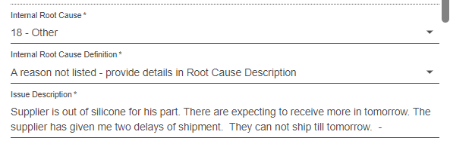
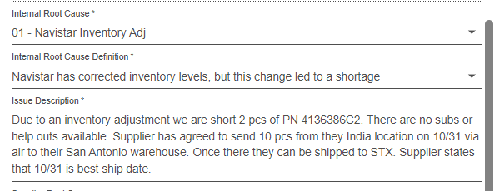
Level 1 Planner | No escalation needed
1
2
3
4
5
6
Planner
Planner Escalation
SCIS
SCIS
Escalation
Command Center
Command Center Escalation
Commercial
Questions to address
Control Tower Tools
Official Portal
Sources
Which scenarios do not require escalation?
There is plan in place with no room for improvement
Example:
Example:
Planner
Responsible(s)
Planner Supervisor
NOTES
None

Slide 36
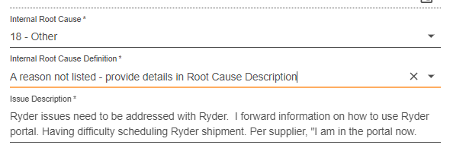
Level 1 Planner | No escalation needed (cont.)
1
2
3
4
5
6
Planner
Planner Escalation
SCIS
SCIS
Escalation
Command Center
Command Center Escalation
Commercial
Questions to address
Control Tower Tools
Official Portal
Sources
Which scenarios do not require escalation?
Logistics Ryder issue
Example:
Planner
Responsible(s)
Planner Supervisor
NOTES
Ryder/transportation issues need to be worked directly with Ryder

Slide 37
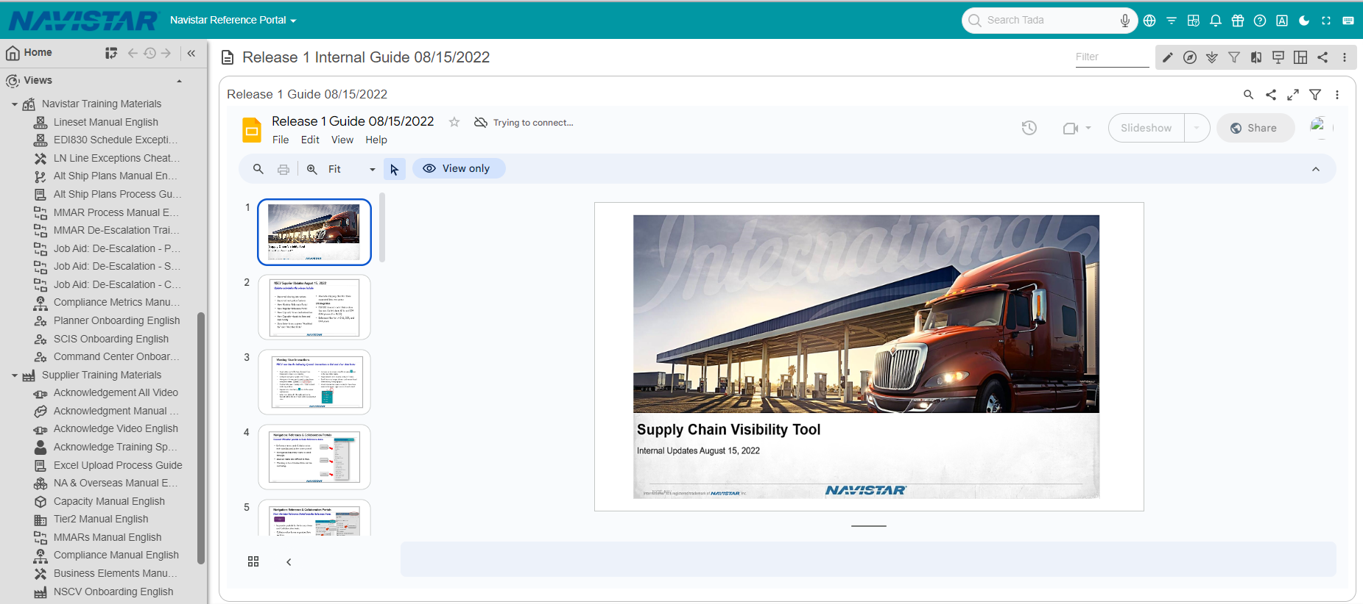
Level 1 Planner | TADA training
1
2
3
4
5
6
Planner
Planner Escalation
SCIS
SCIS
Escalation
Command Center
Command Center Escalation
Commercial
Questions to address
Control Tower Tools
Official Portal
Where can I find more information regarding TADA usage and available features?
Sources
Detailed instructions available in TADA
International Training User Guide
Planner
Responsible(s)
Planner Supervisor
Supplier Training User Guide
Link for detailed instructions in TADA:
International Reference Portal
International Training Materials>Planner Onboarding English
NOTES

Slide 38
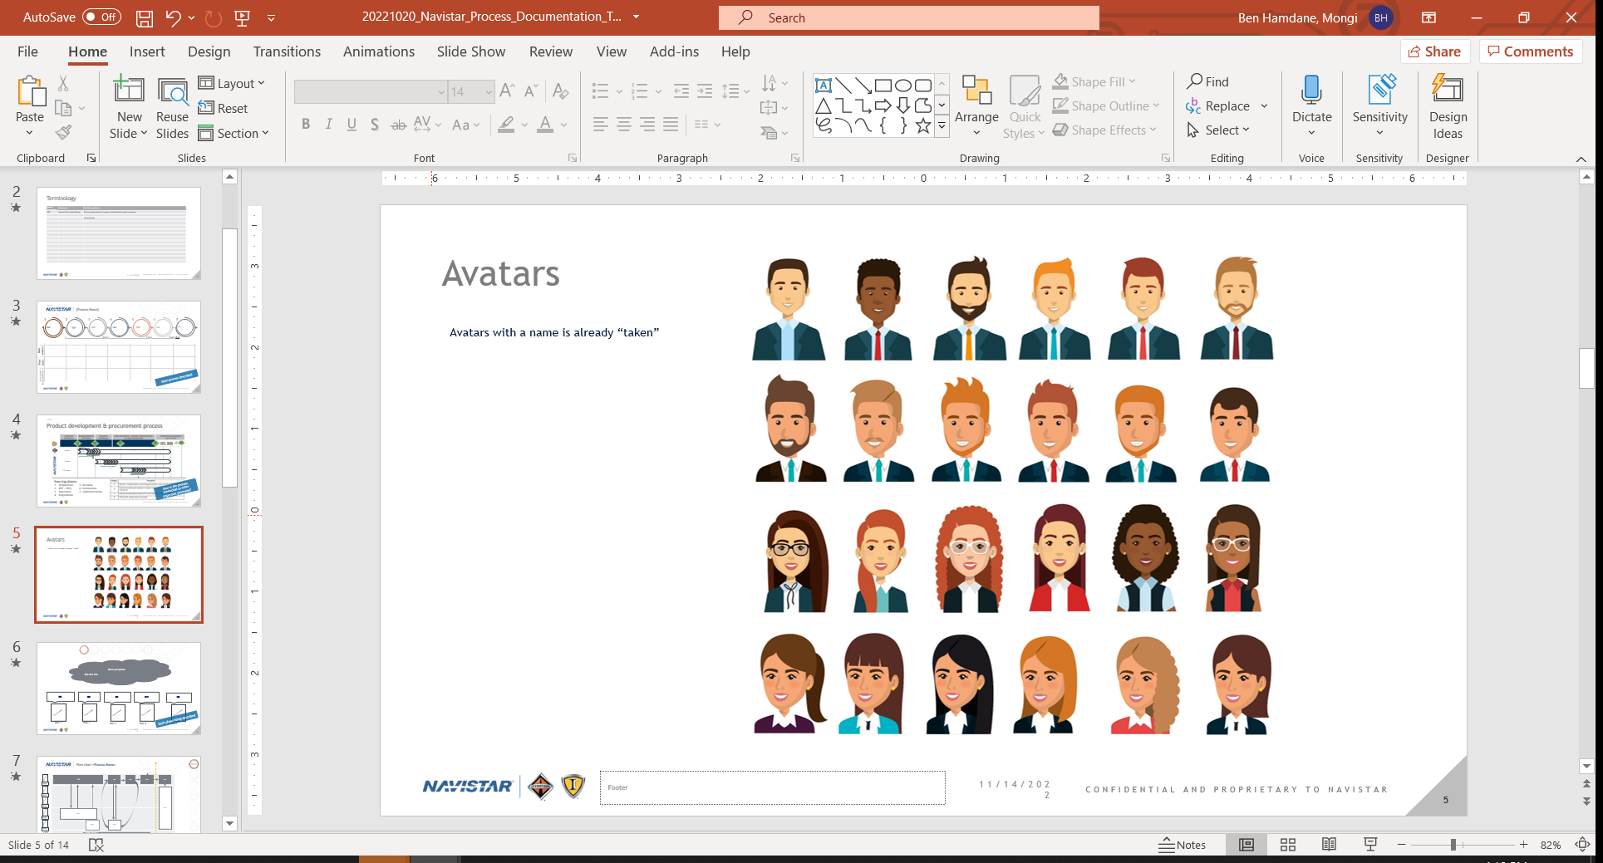

Level 3 SCIS | Killer Bee Meeting Structure
1
2
3
4
5
6
Planner
Planner Escalation
SCIS
SCIS
Escalation
Command Center
Command Center Escalation
Commercial
Questions to address
Killer Bee
MS Teams (repository)
Sources
What is the main communication channel for escalation events?
How to communicate escalation event statuses?
Meeting Objectives
Escalation of top issues (MMARs / SAIs)
Provide critical events status from SCIS / CC to plants
Request support to other areas (Engineering / Logistics / Deviations)
Receive feedback from plant regarding impacts and severity from an escalation event
High level process flow
Escalation event (MMAR / SAI)
Escalation
Escalation
Material Planning
Supply Chain Improvement Services
Command Center Manager
2X meeting per day: 8.00 hrs CST
15.30 hrs CST
30 min each meeting
Meeting duration
Communication of critical escalation events
Supplier
Killer
Bee
Audience
Command Center representatives (Managers)
SCIS representatives
Plant representatives (SC Manager / SC Supervisor)
Engineering representative

Slide 39

Thank you for your participation!
Escalation Management Process
Q&A

Slide 40
APPENDIX

Slide 41
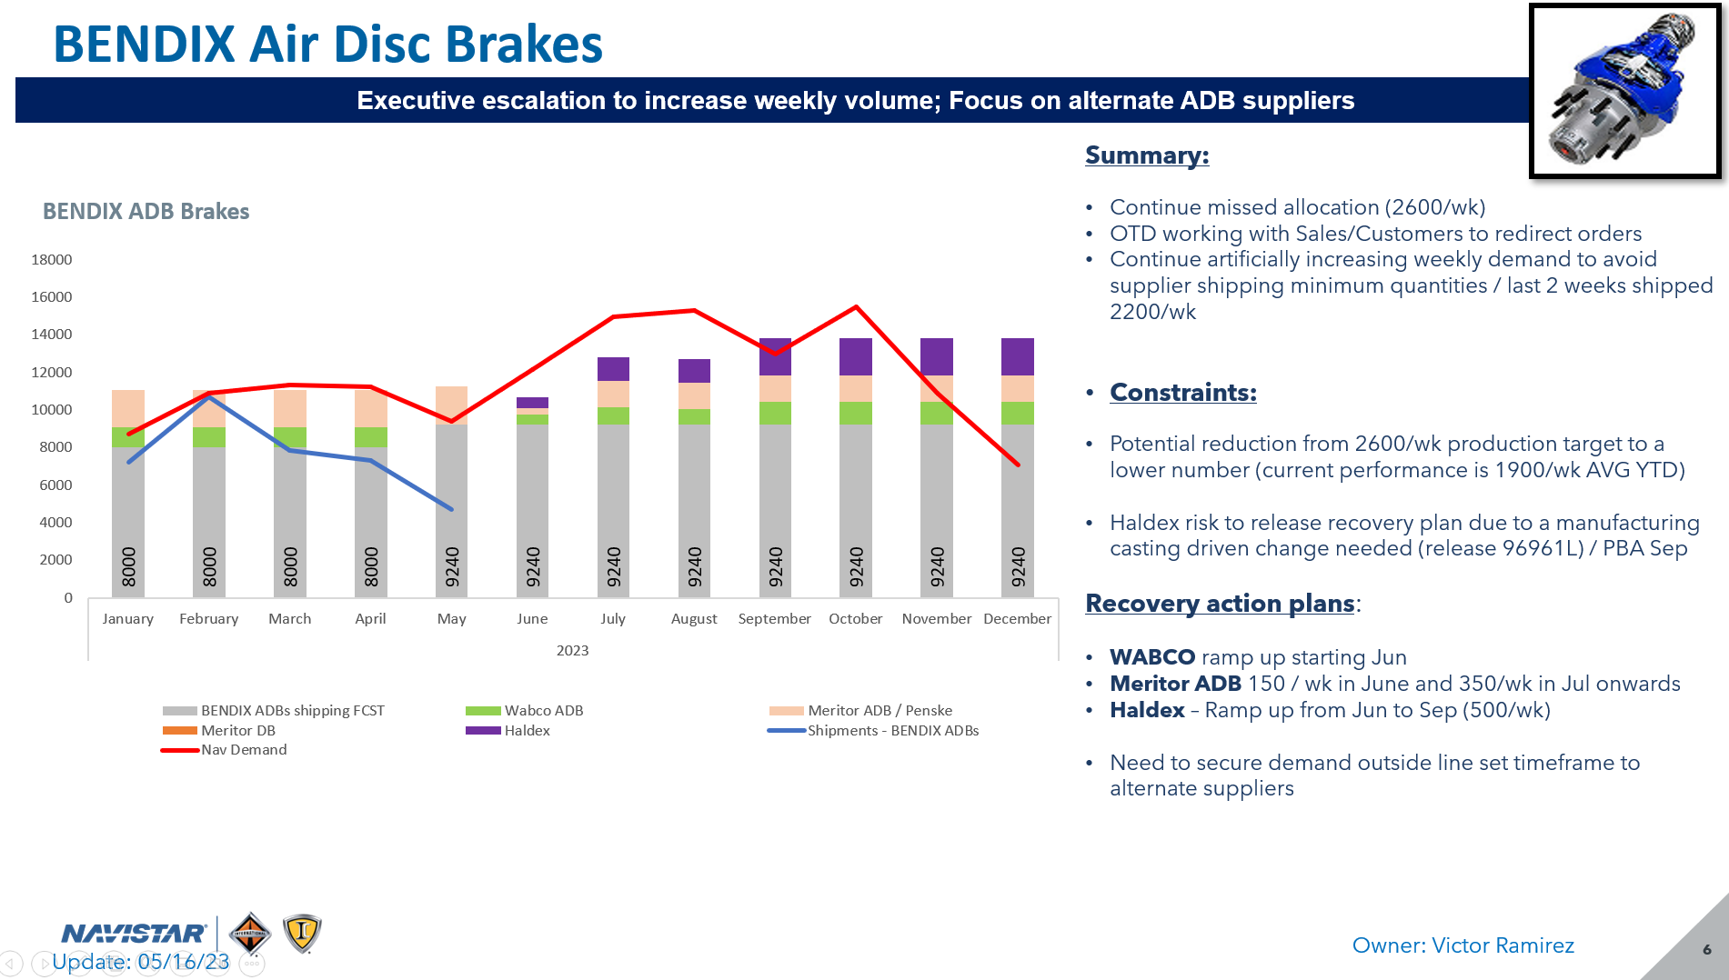
COMMAND CENTER: SUPPLY AND DEMAND MODEL
Red Line
International demand
Source:
EDI 830 / 866 (TADA Portal / Command Center)
Power EDI 830 (52 weeks)
Notes:
Demand available for LN and non-LN International locations
Grey bars
Supplier shipping plan or allocation to International business
Source:
Supplier
Notes:
Average past real supply can help to validate upcoming plans
SUPPLY-DEMAND SECTION
Week of July 4th Shut down
7
Yellow Line
Supply – Demand balance
Source:
Calculated field
Notes:
Positive ➔ Covered
Negative ➔ Supply disruption
Message boxes
- Only as required to highlight a shift or key point on the chart like incremental impact to supply
7
Blue Line:
Real shipping performance driven by ASNs
Source:
EDI 856 ASN (TADA / International Reference Portal)
Notes:
ASNs just available for non-LN International locations
If ASNs not available, then use supplier (shipments) / planner (receipts)
Time frame
Time frame can be either daily or weekly, depending on the impact closeness of the disruption

Slide 42

COMMAND CENTER: SUPPLY AND DEMAND REPORT
2
Purpose: Confirm and visualize a true capacity supply restriction by identifying:
Impact date & duration
Size of the impact (gap from supply Vs Demand)
Severity of the constraint
Potential restrictions in terms of: Material, Machine, Manpower
1
3
4
7
5
General:
Font: Avenir Next LT Pro
6
8
GENERAL INFORMATION
Title:
Supplier Name and Product family
Photo of product:
Upper right-hand corner with border
Header:
Dark blue background with white font explaining the main takeaway message of the slide
What would the headline read when opening a newspaper?
Key issues and key recovery action separated by half colon
SUMMARY, CONSTRAINTS & RECOVERY ACTIONS
Orange font reserved for significant, help needed, or decision required
Summary:
- What is the key issue? Use bullets
- What are the most current key developments?
- Use as few words as possible to convey the message
Constraints:
- Brief description of root cause
- What is preventing to continue with needed material supply?
(material, machine, manpower)
Recovery actions:
- Specific actions that provide incremental improvement
DO include action, date, incremental quantity/week executed
DON´T include actions not impacting recovery (meetings)
SUPPLY-DEMAND SECTION
Graph need to be pasted as an editable object (not a picture),
Message boxes
- Only as required to highlight a shift or key point on the chart like incremental impact to supply
Date updated:
- Blue text font in lower left corner
1
4
2
7
3
5
8
6

Slide 43







Level 1 Planner | De-Escalation process
1
2
3
4
5
6
Planner
Planner Escalation
SCIS
SCIS
Escalation
Command Center
Command Center Escalation
Commercial
Questions to address
Control Tower Tools
Official Portal
Reports
De Escalate to planning supervisor
PCA - Permanent Corrective action(s)
Escalation Event closure
ICAs – Interim Corrective action(s)
Expedited freight improvement
Milestones
Root Cause
POA improvement
Action plan
Sources
Plan In place PIP
How an escalation event is de- escalated and requirements for each step
Tool
Killer
Bee
Stopping International
TOP ISSSUES
Impacts identified
De escalation flow
Plan in place
Follow up
DE-ESCALATION CRITERIA
5 Why analysis
Recovery date identified
Run down chart included
Planner agreed to shipping plan
No impact at plants
if the Recovery Plan goes sideways, the PIP on the associated MMAR/SAI must move back to “active" (no plan in place)
PCA outline included in TADA
30-60-90 Plan
Deliverables
90% improvement trend
Monitor to ship per EDI
Monitoring required from planning team
NOTES
De-escalation milestones should include proper evidence:
Updating the corresponding features / statuses
Attaching the aligned templates
Creating the communication internal messages
All the above to be attached in the TADA system as supporting documentation.

Slide 44
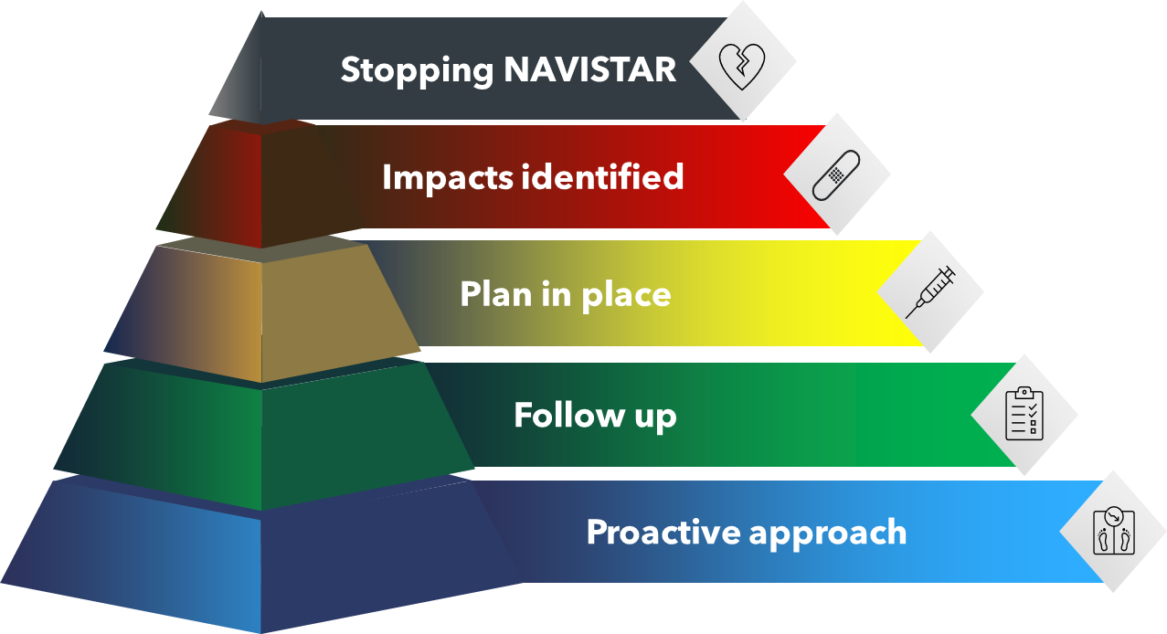
Level 3 SCIS | Killer Bee Meeting Structure (cont.)
1
2
3
4
5
6
Planner
Planner Escalation
SCIS
SCIS
Escalation
Command Center
Command Center Escalation
Commercial
Questions to address
Killer Bee
MS Teams (repository)
Sources
What is the main communication channel for escalation events?
How to communicate escalation event statuses?
New Killer Bee additions
Decide Top Issues (Black & Red) to discuss in the PM
TOP ISSUES
Killer
Bee
Led by SCIS representative
3:30 PM CST update
Escalation & comm updates
Feedback
Feedback
SCIS update
SCIS update
SCIS update
Killer
Bee
PCC update
PCC update
PCC update
8:00 AM CST update
Led by Command Center representative
Escalation event status
Top Issues: Black & Red escalation events
NOTES:
Link to Killer Bee:Killer Bee Report

Slide 45
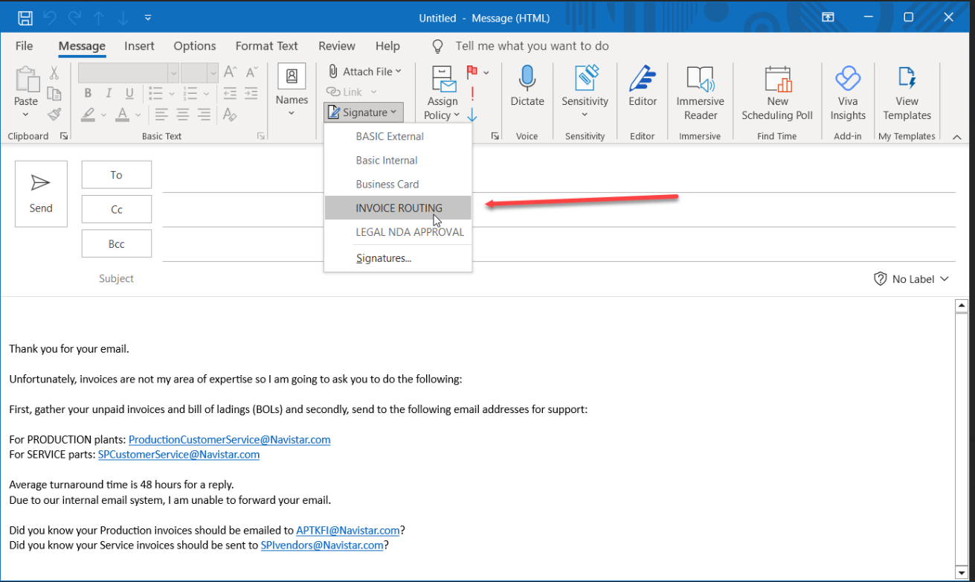
Level 1 Planner | Escalation event required – CONTRACT & PAYMENT ISSUES
1
2
3
4
5
6
Planner
Planner Escalation
SCIS
SCIS
Escalation
Command Center
Command Center Escalation
Commercial
Questions to address
Official Portal
Has the Supply Manager been notified first?
Is the Supplier stopping shipment(s)?
Can they provide the invoices and bill of lading in question?
Sources
Suggested response to the Supplier, non-line down situations
It is recommended to add a custom signature to outlook when a supplier inquires on a payment issue.
Responsible(s)
Planner
In Outlook, select File and Options
Select Mail then scroll to find “Signature”
When you’re in “Signature” you can create a separate “Signature” to select when replying to the Supplier about Payments.
NOTES

Slide 46
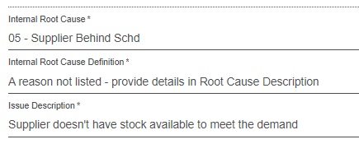
Level 1 Planner | Bad escalation event (cont.)
1
2
3
4
5
6
Planner
Planner Escalation
SCIS
SCIS
Escalation
Command Center
Command Center Escalation
Commercial
Questions to address
Official Portal
Sources
What is considered a bad escalation event?
Why doesn’t supplier have stock?
Example:
Planner
Responsible(s)
Planner Supervisor
NOTES
Need a brief description on why the supplier cannot meet demand and what assistance is needed from the escalation case owner.

Slide 47
Level 1 Planner | No escalation needed reasons
1
2
3
4
5
6
Planner
Planner Escalation
SCIS
SCIS
Escalation
Command Center
Command Center Escalation
Commercial
Questions to address
Sources
Which reasons do not require a MMAR / SAI escalation event?
Official Portal
Responsible(s)

Slide 48
Level 1 Planner | Escalation internal root causes
1
2
3
4
5
6
Planner
Planner Escalation
SCIS
SCIS
Escalation
Command Center
Command Center Escalation
Commercial
Questions to address
NOTES
Sources
If no a valid internal root cause provided (place holder, other, etc.), then the escalation event will not proceed and will be returned to the originator
Who do we need to engage for valid internal root causes?
Official Portal
NOTES
(L) - Leader (S)- Support
SCIS – Supply Chain Information Services
CC – Command Center
PMO – Project Management Office
SM – Supply Manager
CM – Category Manager
Responsible(s)

Slide 50

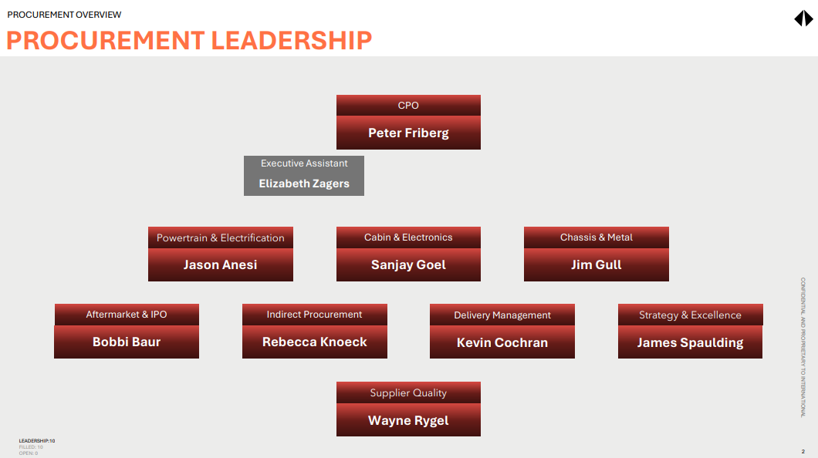
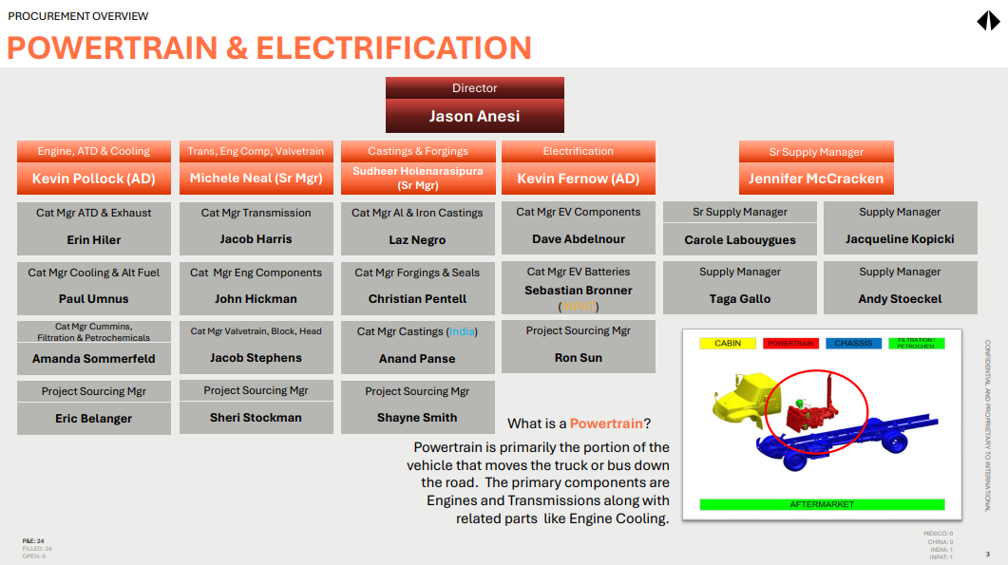
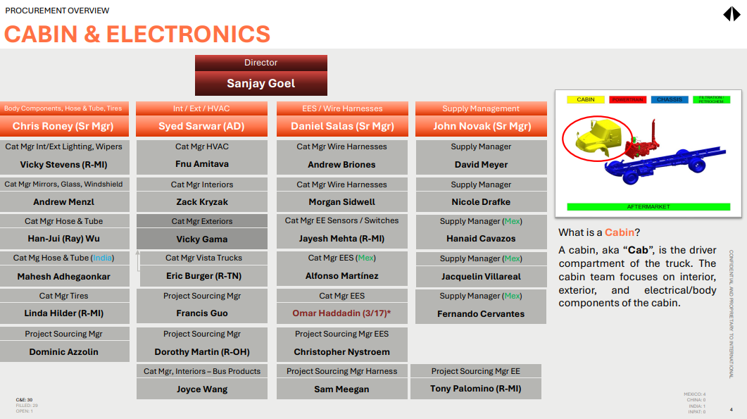
Level 1 Planner | Escalation internal Escalation
1
2
3
4
5
6
Planner
Planner Escalation
SCIS
SCIS
Escalation
Command Center
Command Center Escalation
Commercial
Questions to address
Power Apps
Procurement Portal site
How to identify commercial contacts?
Sources
Detailed Procurement Org Charts
Procurement organization chart
PDF file updated as changes occur
Procurement Portal link:
https://apps.powerapps.com/play/e/53770084-6a01-41b5-bc30-83f716337378/a/35454712-8436-468d-ae59-0ff12a54d402?tenantId=b5a920d6-7d3c-44fe-baad-4ffed6b8774d&hint=d690edd7-dd7a-467a-a42c-3550b70d39e8&sourcetime=1701699531605
NOTES

Slide 51

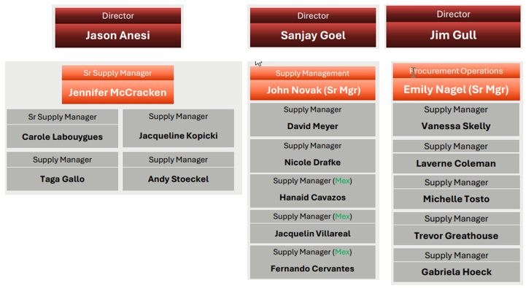
Level 1 Planner | Escalation internal Escalation
1
2
3
4
5
6
Planner
Planner Escalation
SCIS
SCIS
Escalation
Command Center
Command Center Escalation
Commercial
Questions to address
BaaN
Command Ctr
Who do we need to engage for payment & contract issues/stop ship
Sources
Procurement Supply Mgmt escalation
NOTES
Make sure the supplier provides all invoices & BOLS ● Talk to your Plant Receiving & Finance Team ● Recommend the Supplier reach out to AP Mailbox
Procurement Portal link

Slide 52
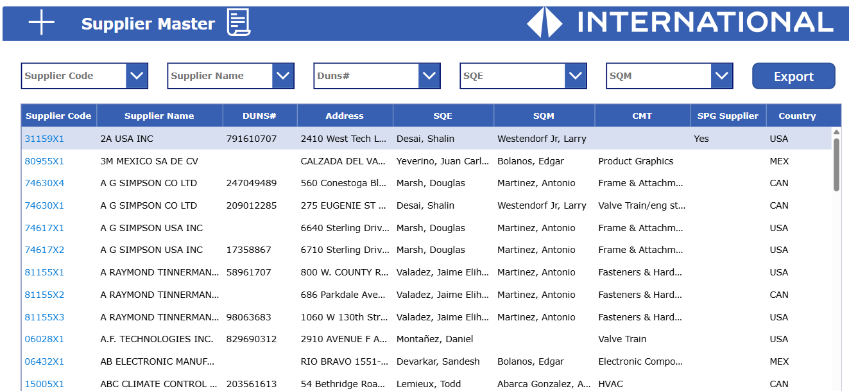
Level 1 Planner | Escalation internal Escalation
1
2
3
4
5
6
Planner
Planner Escalation
SCIS
SCIS
Escalation
Command Center
Command Center Escalation
Commercial
Questions to address
Power Apps
Supplier Master Dashboard
How to identify supplier quality contacts?
Sources
INTL Supplier quality information by:
Supplier Code
Supplier Name
DUNS number
Supplier Address
Supplier Quality Engineer SQE assigned
Supplier Quality Manager SQM assigned
Category tower assigned CMT
Country
SUPPLIER QUALITY CONTACTS
Supplier Master link:
https://apps.powerapps.com/play/e/default-b5a920d6-7d3c-44fe-baad-4ffed6b8774d/a/918fbaac-ab08-46de-8f15-0de37f8d5b50?tenantId=b5a920d6-7d3c-44fe-baad-4ffed6b8774d&amp%3Bhint=0d5d7714-892b-4247-a3b7-4d5e147a2064&amp%3Bsourcetime=1701777553418&source=sharebutton&sourcetime=1741615841437
NOTES

